Slide 1
A Differential Theory of Radiative Transfer
Cheng Zhang¹, Lifan Wu², Changxi Zheng³,
Ioannis Gkioulekas⁴, Ravi Ramamoorthi², and Shuang Zhao¹
¹University of California, Irvine ²University of California, San Diego
³Columbia University ⁴Carnegie Mellon University
Notes:
Thanks for the introduction and thank you all for attending my talk. I am Cheng from UC Irvine. I am going to present our recent work on a differential theory of radiative transfer.

Slide 2
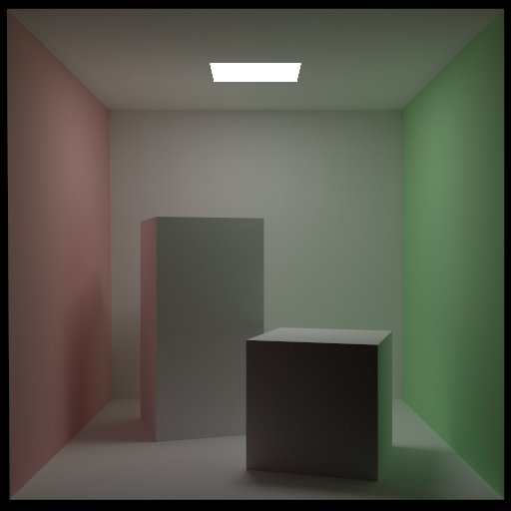




What is differentiable rendering?
Photorealistic
image I
Rendering
Geometry
Camera
Differentiable
rendering
Material
Light
?
3D Scene
Derivative
image I’
Notes:
Given a fully described 3D scene, we know how to render a photorealistic image pretty well.
(click) Differentiable rendering, in contrast, focuses on computing the derivative of the image with respect to a certain parameter, say the position or color of an object in the scene.
This challenging problem has remained underexplored in computer graphics.

Slide 3
Why do differentiable rendering?
Inverse rendering
Enabling gradient-based optimization
Machine learning
Backpropagation through rendering
Notes:
Differentiable rendering has recently received great attention because it has a few important applications.
For example, it is a central ingredient for solving inverse rendering problems using gradient-based methods such as stochastic gradient descent.
Also, it allows integrating complex light transport simulations into machine learning pipelines efficiently by enabling backpropagating gradients through the rendering processes.

Slide 4
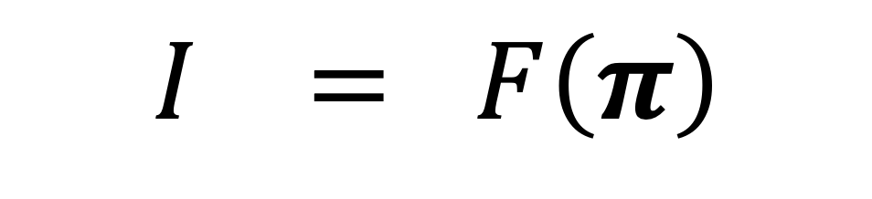
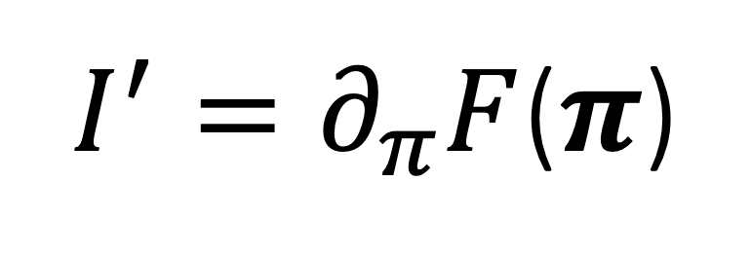
Rendering
$$I = F\left(π\right)$$
Photorealistic image
Scene parameters
Differentiable rendering
$I^{′}=∂_{π}F$($π$)
derivative image
Notes:
The rendering process can be considered as a function F that maps scene parameters to rendered images.
(click) Similarly, differentiable rendering is about computing the derivative of F with respect to scene parameters.

Slide 5




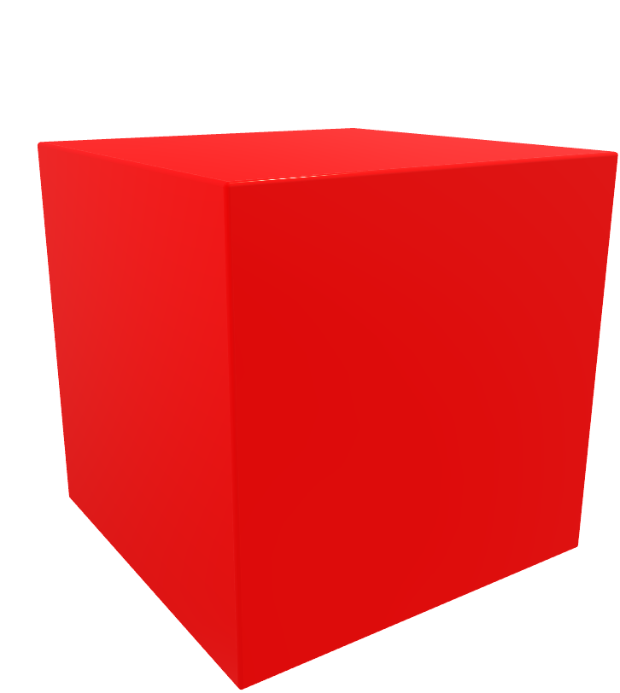

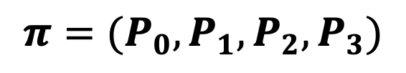
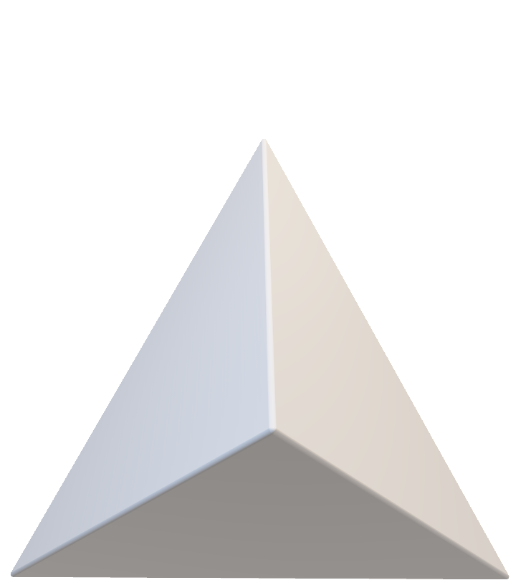

Scene Parameters
$$P_{0}$$
$$P_{1}$$
$$P_{2}$$
$$P_{3}$$
$$π=k_{d}$$
$$π=(P_{0},P_{1},P_{2},P_{3})$$
$$π=σ_{t}$$
Notes:
A scene is typically described using many parameters. These can include the diffuse albedo of a surface, (click) positions of mesh vertices, and (click )spatially varying density of a medium (pause)

Slide 6
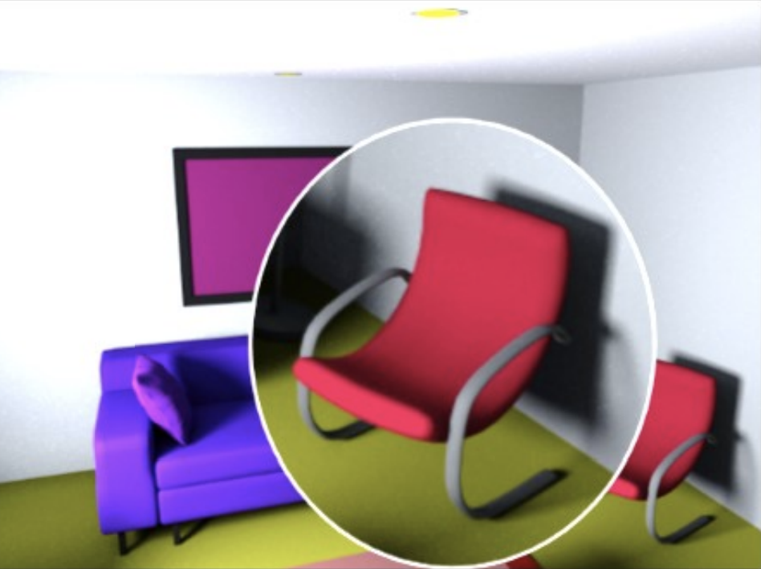
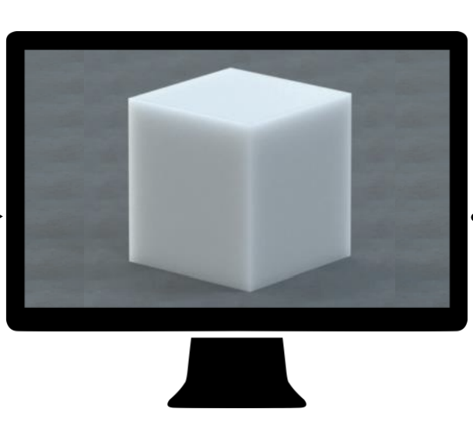
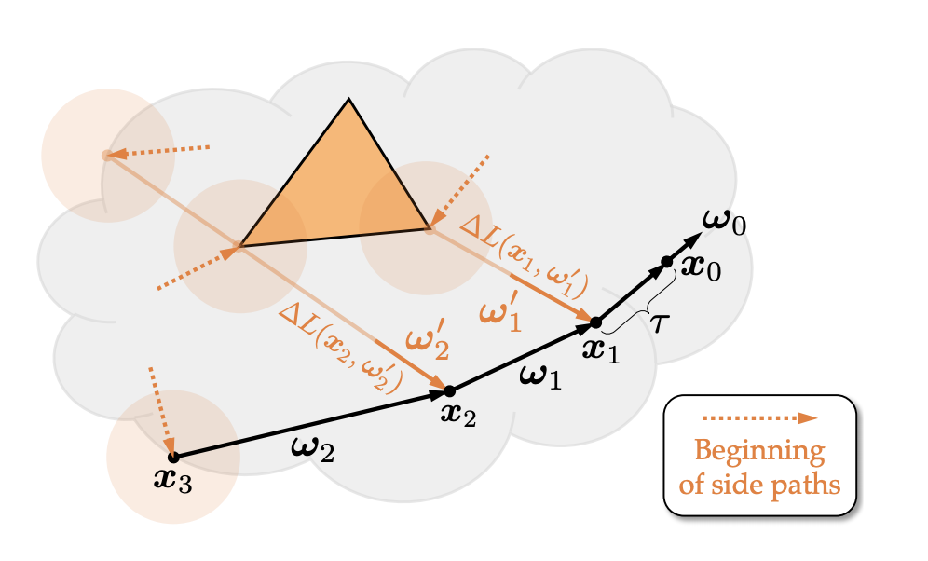
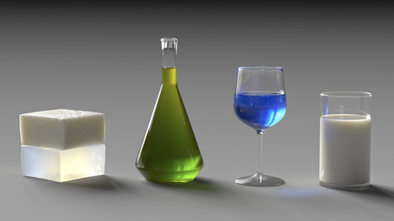


Previous work
Azinovic et al. 2019
Li et at. 2018
Gkioulekas et al. 2013
Che et at. 2018
Our Method
Geometry
Surface effect
Volumetric effect
Notes:
Previous techniques on differentiable rendering usually focus on computing image derivatives with respect to some specific parameters. Unfortunately, they lack the generality to handle complex light transport effects or to differentiate with respect to arbitrary scene parameters.
For example, some of them neglects volumetric effects while others cannot differentiate wrt geometry.
(click) All these methods are theoretically special cases of our technique (pause).

Slide 7
Our Contributions
Differential theory of radiative transfer
Captures all surface and volumetric light transport effects
Supports derivative computation with respect to any parameters
Monte Carlo estimator
Unbiased
Analogous to volumetric path tracing
Notes:
Our contributions include a new differential theory of radiative transfer.
Our theory captures all surface and volumetric light transport effects and can handle arbitrary scene parameters.
Also, we introduce a new Monte Carlo method to estimate image derivatives in an unbiased fashion.

Slide 8


Recap: Radiative Transfer
$$ω$$
$$x$$
Notes:
Before introducing our differential theory, let’s first revisit how radiative transfer works.
Under this framework, the radiance at a given point and direction is determined by the amount of light scattered into this direction behind the point. (click) The amount of in-scattered light is in turn computed by integrating light coming from all directions.

Slide 9
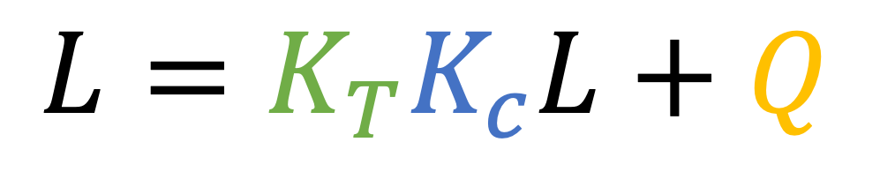




Recap: Radiative Transfer Equation
Transport
operator
Collision
operator
Source
$$K_{c}$$
$$L=K_{T}K_{c}L+Q$$
Radiative transfer equation (RTE)
A linear transport equation
$$ω$$
$$K_{T}$$
$$x$$
Notes:
Mathematically this is described by the radiative transfer equation. Here we show the RTE in its operator form for simplicity, where the two operators describes what we just discussed.

Slide 10
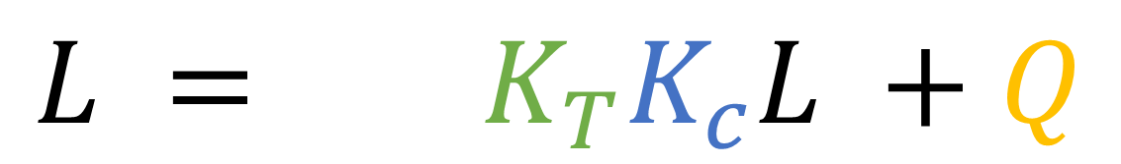
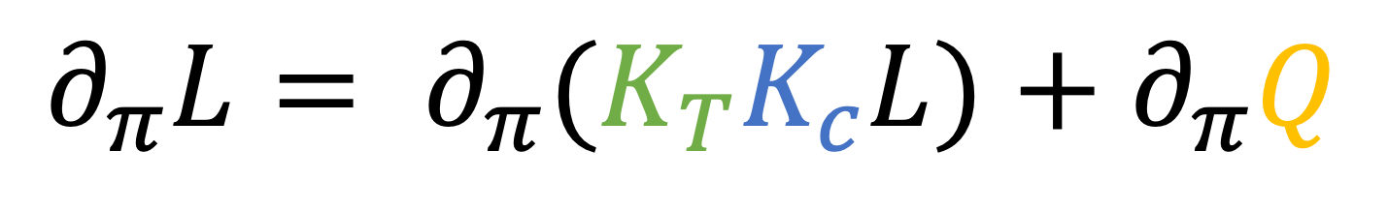
Differentiating the RTE
$$L = K_{T}K_{c}L +Q$$
Differentiating both sides
$$∂_{π}L= ∂_{π}(K_{T}K_{c}L)+∂_{π}Q$$
Differentiating individual operators
Notes:
Computing derivative images generally requires differentiating the radiance.
In case of radiative transfer, this boils down to differentiating both sides of the RTE.
(click) Specifically, to calculate the derivative of the right-hand side, we need to differentiate individual operators.
Next, we show more details on how this can be done.

Slide 11
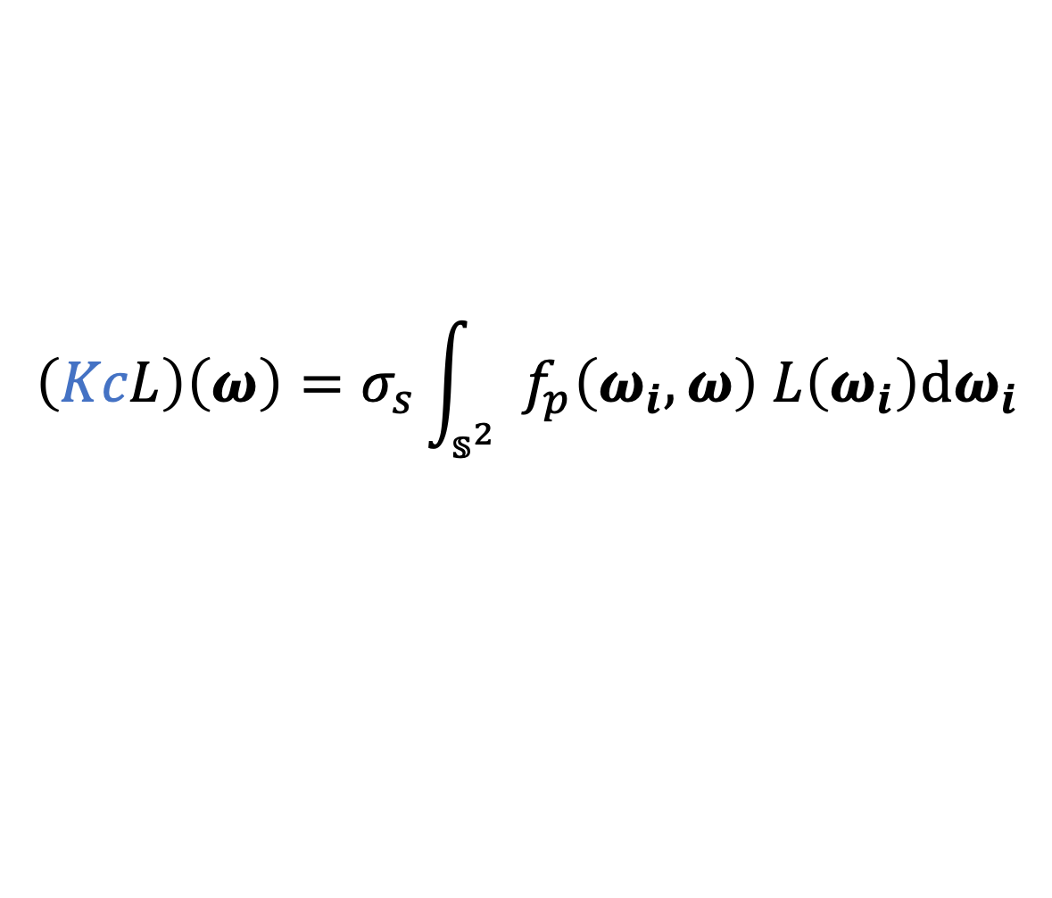
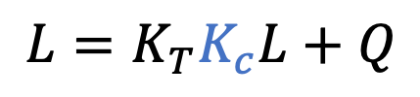
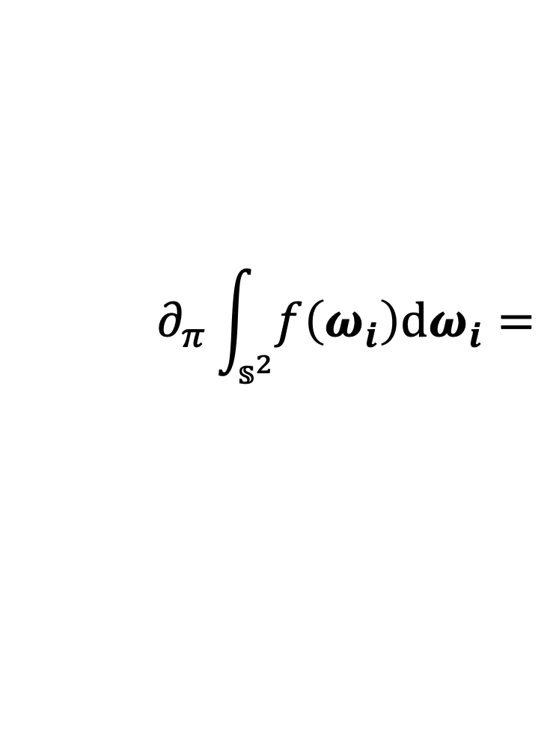
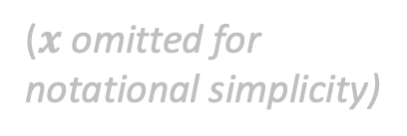
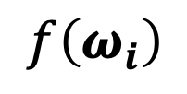
Differentiating the Collision Operator
RTE:
$$L=K_{T}K_{c}L+Q$$
($x$ omitted for notational simplicity)
$$f\left(ω_{i}\right)$$
$$\left(KcL\right)\left(ω\right)=σ_{s}\int_{𝕤^{2}}{{ f}_{p}\left(ω_{i},ω\right) L\left(ω_{i}\right)dω_{i}}$$
Scattering
coefficient
Phase
function
$$∂_{π}\int_{𝕤^{2}}{f\left(ω_{i}\right)dω_{i}=}$$
?
Requires differentiating a (spherical) integral
Notes:
First, let’s look at the collision operator which is given by the scattering coefficient times a spherical integral of radiance modulated by the phase function.
(click) The key to differentiate this operator is to handle the integral. (pause)

Slide 12

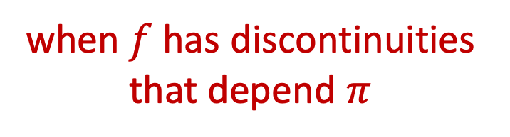
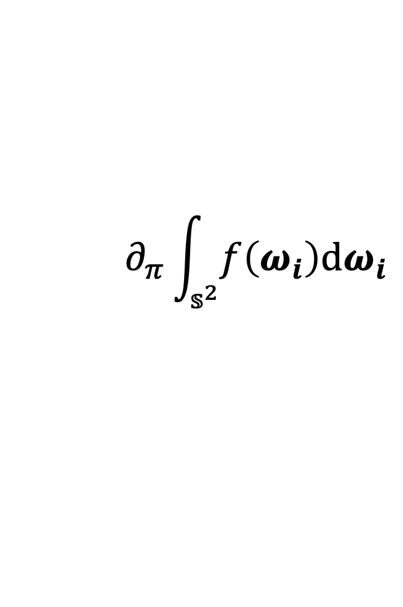
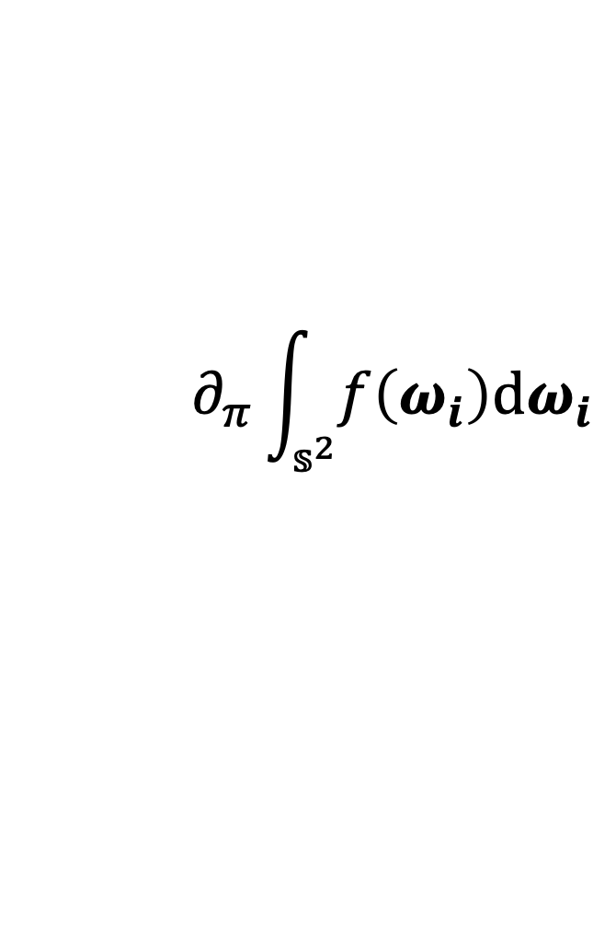
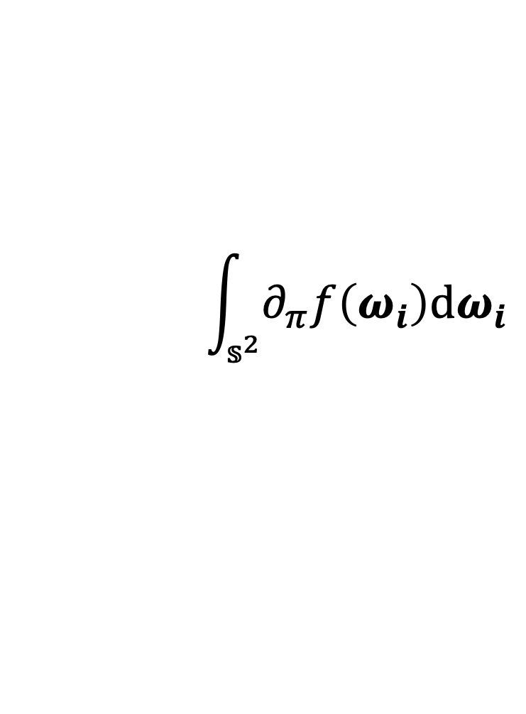
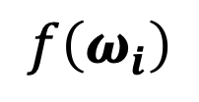



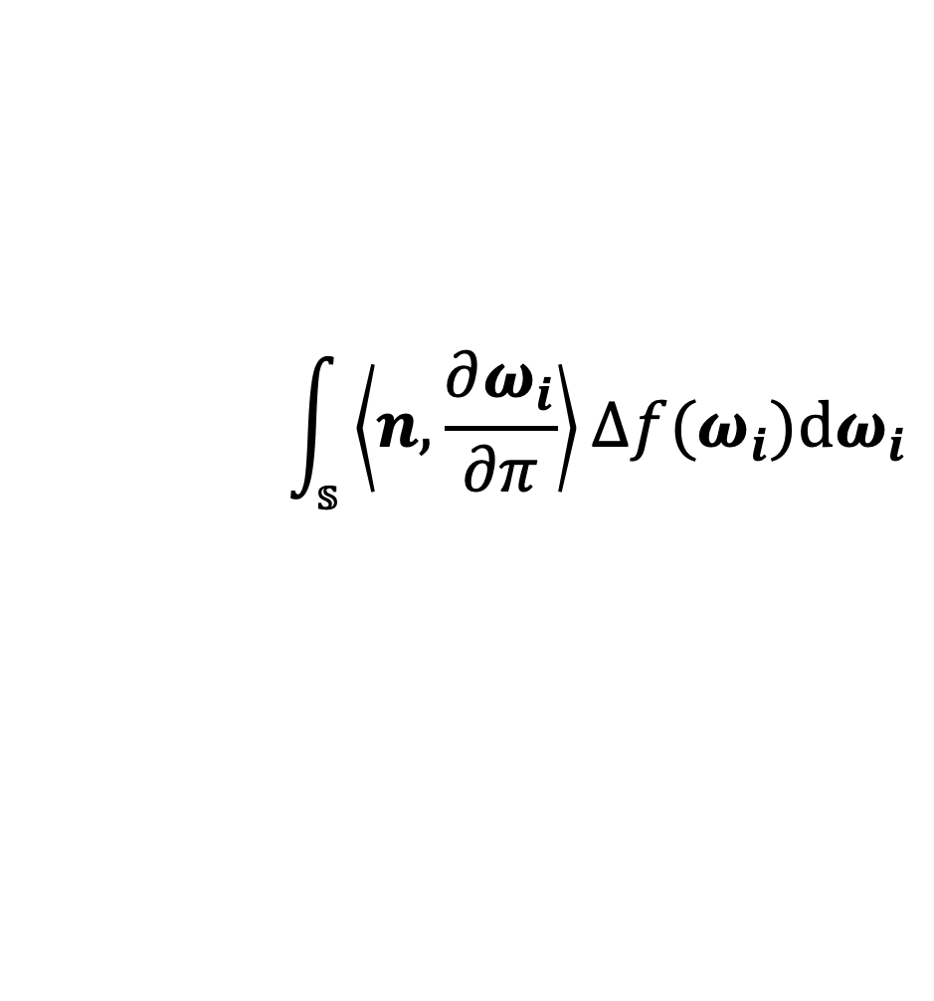
Differentiating the Collision Operator
$$f\left(ω_{i}\right)$$
$$\left(K_{c}L\right)\left(ω\right)=σ_{s}\int_{𝕤^{2}}{{ f}_{p}\left(ω_{i},ω\right) L\left(ω_{i}\right)dω_{i}}$$
$$∂_{π}\int_{𝕤^{2}}{f\left(ω_{i}\right)dω_{i}}$$
$$\int_{𝕤^{2}}{∂_{π}f\left(ω_{i}\right)dω_{i}}$$
$$\int_{𝕤}{\left\langle n, \frac{∂ω_{i}}{∂π}\right\rangle ∆f(ω_{i})dω_{i}}$$
when $f$ has discontinuities
that depend $π$
$$=$$
$$≠$$
$$+$$
Boundary term
$$∂_{π}\int_{𝕤^{2}}{f\left(ω_{i}\right)dω_{i}}$$
(according to Reynolds transport theorem)
(according to Reynolds transport theorem)
Notes:
To differentiate this integral, the most common way is to exchange the order of differentiation and integration, which is precisely what most previous methods did.
(click) However, this can be incorrect when the integrand contains discontinuities that depend on the parameter.
(click) Instead, according to Reynolds theorem originated in fluid mechanics, we need to introduce an extra boundary term to capture the potential changes of discontinuities.

Slide 13


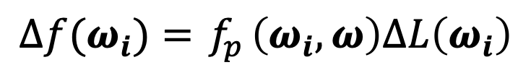
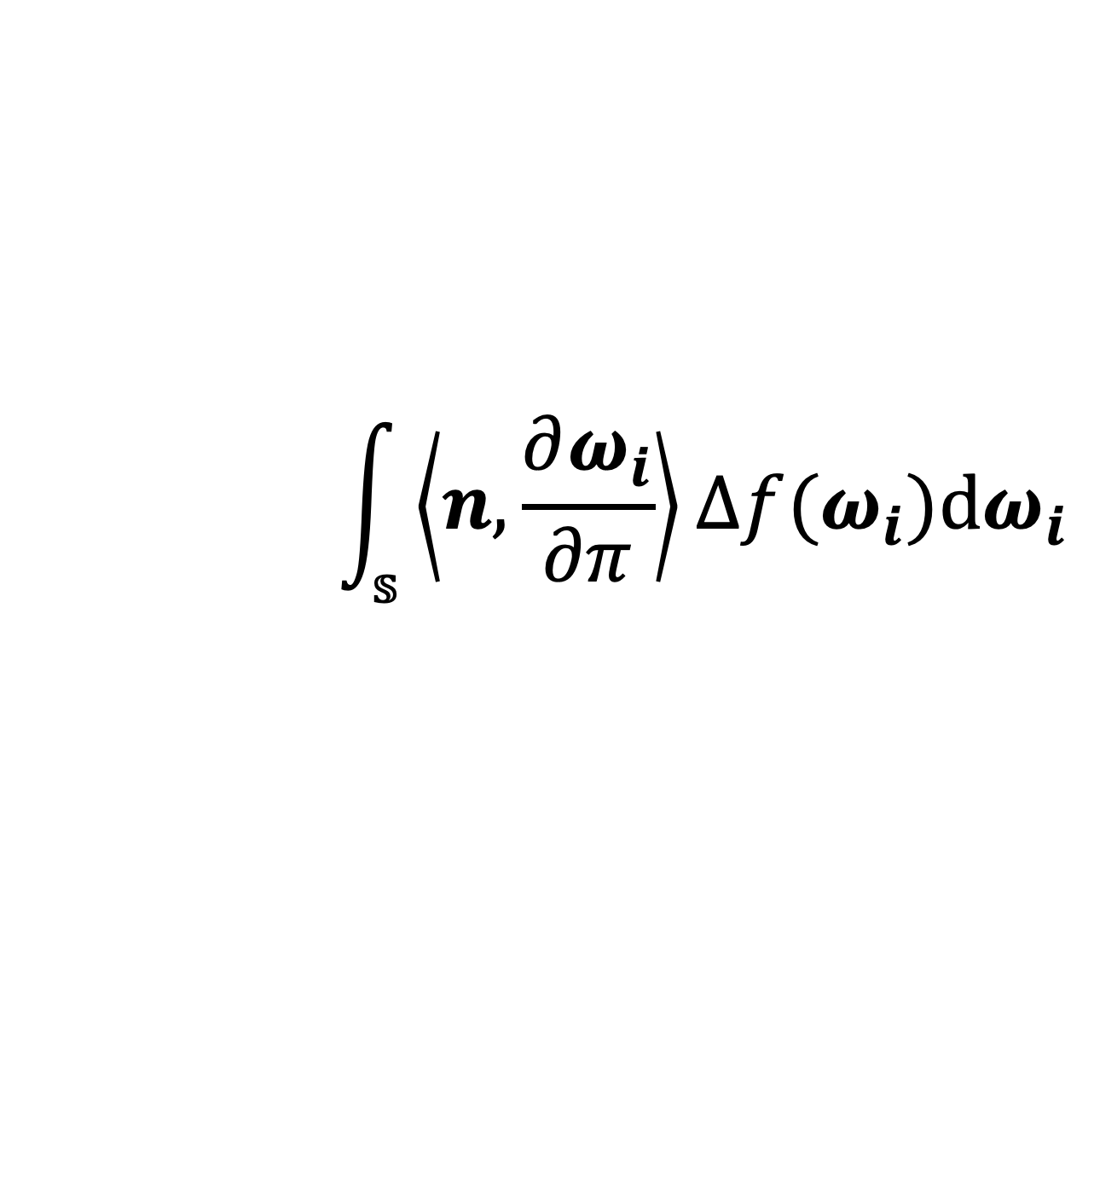
Boundary term
$$f\left(ω_{i}\right)$$
$$\left(K_{c}L\right)\left(ω\right)=σ_{s}\int_{𝕤^{2}}{{ f}_{p}\left(ω_{i},ω\right) L\left(ω_{i}\right)dω_{i}}$$
$$∆f{(ω}_{i})={ f}_{p}\left(ω_{i},ω\right)∆L\left(ω_{i}\right)$$
when${ f}_{p}$ is continuous
$$\int_{𝕤}{\left\langle n, \frac{∂ω_{i}}{∂π}\right\rangle ∆f(ω_{i})dω_{i}}$$
$∆f$is the difference of integrand $f$ across the discontinuity $ω_{i}$
discontinuities of integrand f
change rate of discontinuity (in the normal direction)
Notes:
Now let’s take a closer look at the boundary term.
The integral domain S indicates the discontinuities of the integrand f in $ω_{i}$;
(click) The dot product term is the change rate of discontinuity along the normal direction;
(click) $∆f$ is the difference of the integrand f across the discontinuity location.
(click) If we assume the phase function to be continuous, the only source of discontinuity becomes the radiance. It follows that $∆f$ can be expressed as the product of the phase function and difference of radiance.

Slide 14
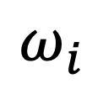
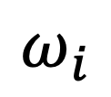

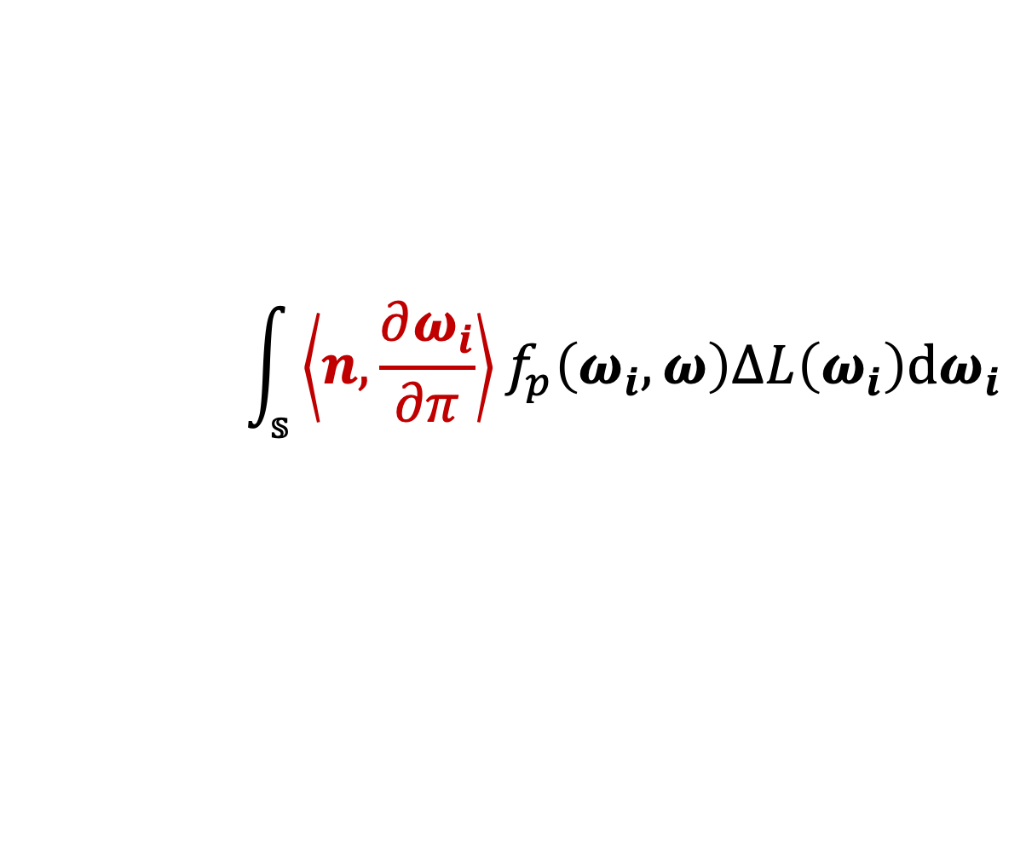
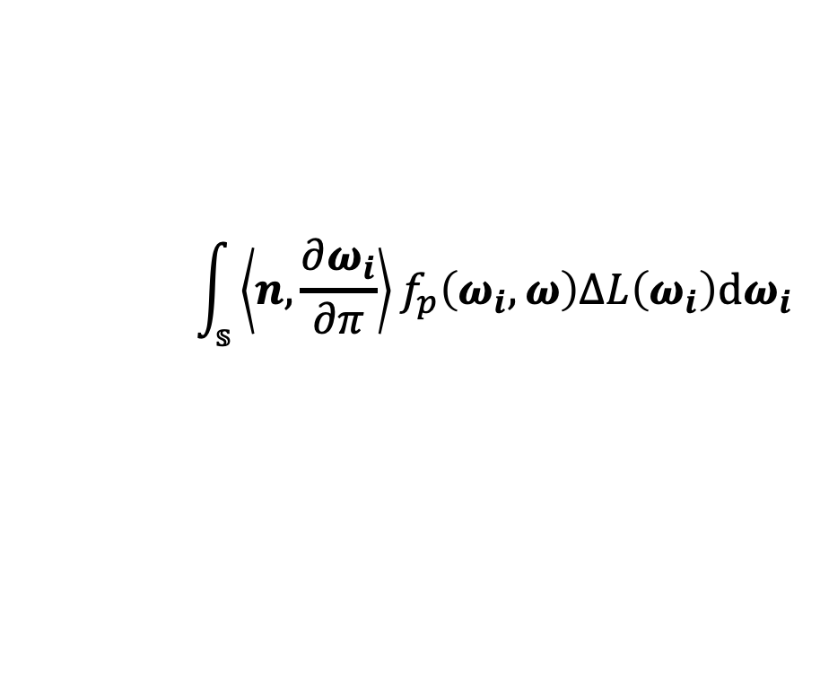
Sources of Discontinuity
The boundary term:
$$\int_{𝕤}{\left\langle n, \frac{∂ω_{i}}{∂π}\right\rangle f_{p}\left(ω_{i},ω\right)∆L\left(ω_{i}\right)dω_{i}}$$
The boundary term:
$$\int_{𝕤}{\left\langle n, \frac{∂ω_{i}}{∂π}\right\rangle f_{p}\left(ω_{i},ω\right)∆L\left(ω_{i}\right)dω_{i}}$$
$$ω_{i}$$
$$ω_{i}$$
$$π$$
Visibility
Normal
Notes:
For better understanding of the boundary term, let's look at a few simple 2D examples.
In the first example, we have a red box occluded by a green box. This change of visibility causes a discontinuity as illustrated here. In other words, when crossing such boundary, the visible object jumps from one to another.
(click) Another type of discontinuity comes from abrupt changes of surface normals.
In this case, all incoming radiance in the orange region comes from the surface with one normal, while in the green region, all incoming radiance is from a surface with a different normal.
We mainly consider these two sources of discontinuities based on certain continuity assumptions.
For more details, please refer to our paper.
(click) We now show how the boundary term is calculated using the first example.
Suppose we are differentiating with respect to the height of green box. Apparently, the discontinuity depends on the height as we can see here (flip back and forth).

Slide 15
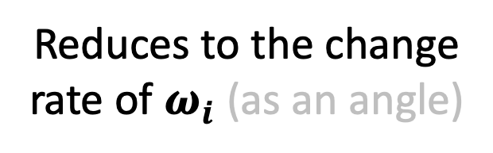
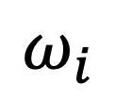

Sources of Discontinuity
The boundary term:
$$\int_{𝕤}{\left\langle n, \frac{∂ω_{i}}{∂π}\right\rangle f_{p}\left(ω_{i},ω\right)∆L\left(ω_{i}\right)dω_{i}}$$
$$ω_{i}$$
Reduces to the change rate of $ω_{i}$ (as an angle)
$$π$$
Notes:
…
(click) In this case, the dot product term reduces to the change rate of $ω_{i}$, as an angle, with respect to the height.
(pause)

Slide 16
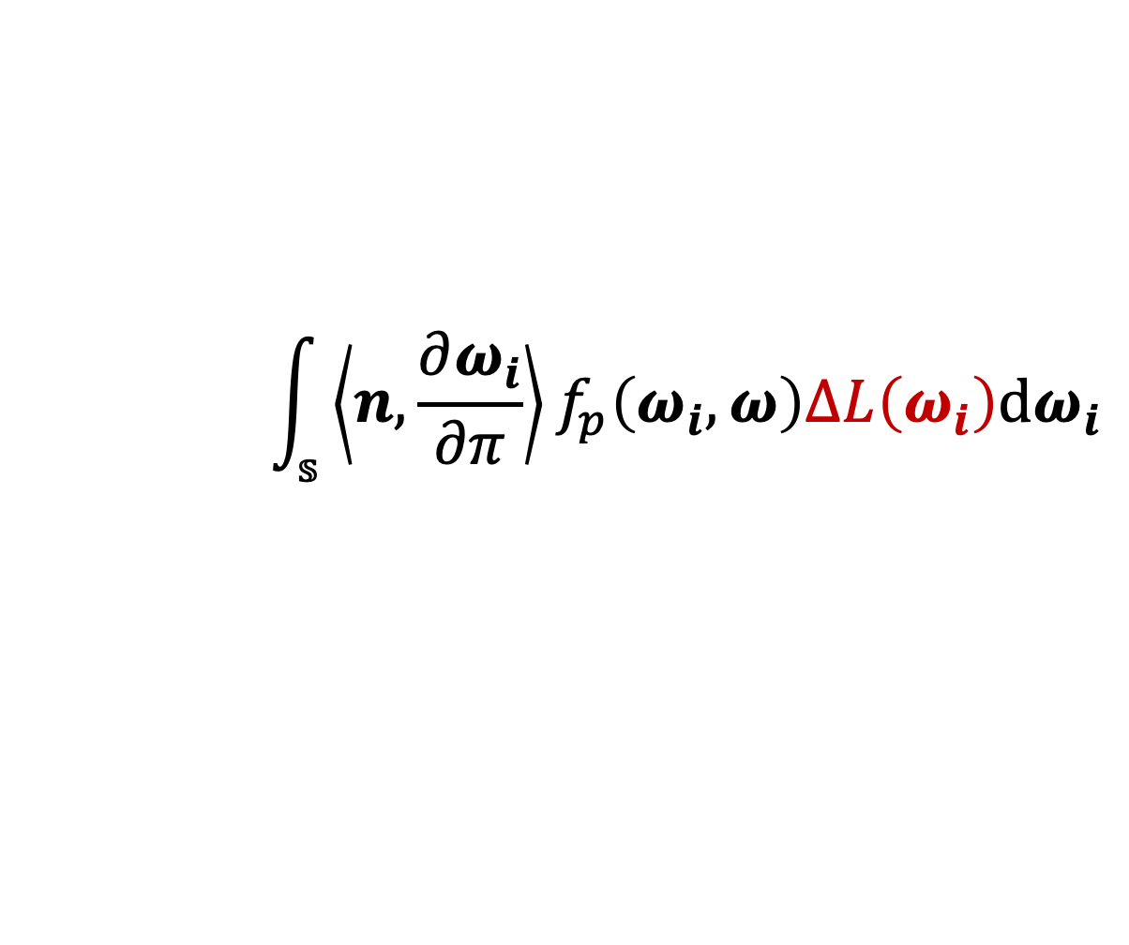
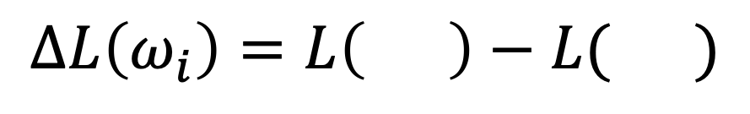
Sources of Discontinuity
The boundary term:
$$\int_{𝕤}{\left\langle n, \frac{∂ω_{i}}{∂π}\right\rangle f_{p}\left(ω_{i},ω\right)∆L\left(ω_{i}\right)dω_{i}}$$
$$ω_{i}$$
$$π$$
$$∆L\left(ω_{i}\right)=L\left( \right)−L( )$$
(with the absence of attenuation)
Notes:
The difference of incoming radiance across the discontinuity point $ω_{i}$ is illustrated here. (pause)

Slide 17

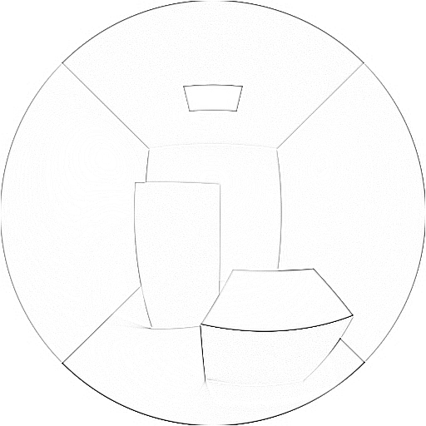
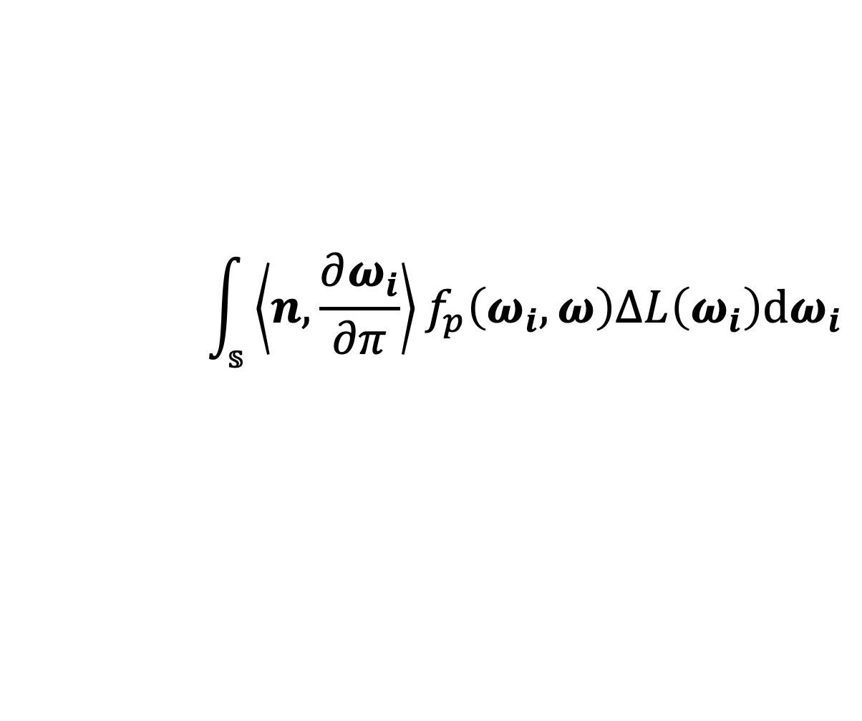
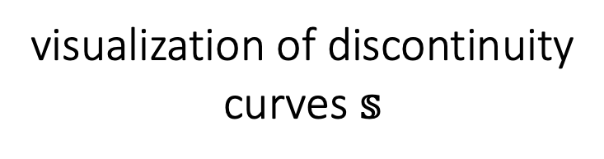
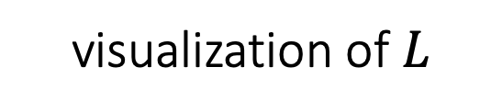
Discontinuities in 3D
visualization of $L$
visualization of discontinuity curves $𝕤$
line integral
$$\int_{𝕤}{\left\langle n, \frac{∂ω_{i}}{∂π}\right\rangle f_{p}\left(ω_{i},ω\right)∆L\left(ω_{i}\right)dω_{i}}$$
Notes:
Discontinuities in 3D are slightly more complicated.
Here we show a visualization of incoming radiance in a Cornell box scene. In this case, the discontinuities are spherical curves, and the boundary terms take the form of line integrals. For more details, please see the paper.

Slide 18
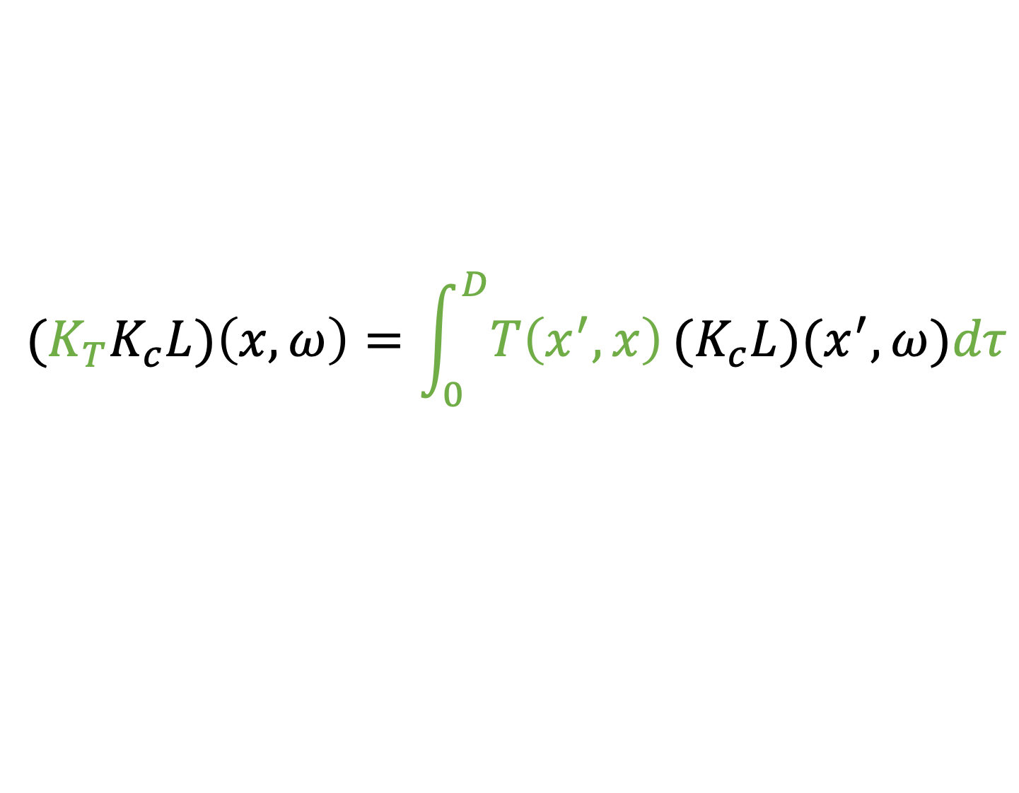
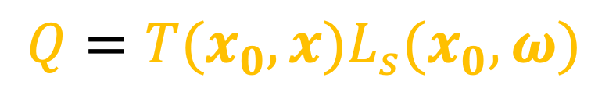
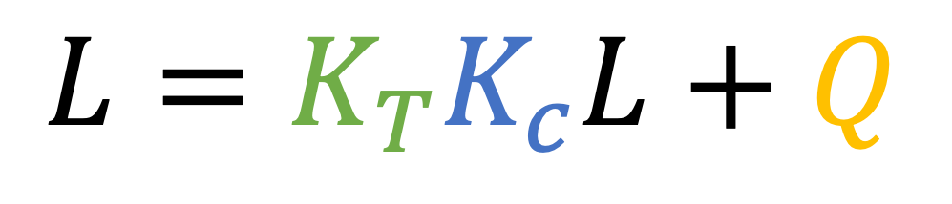
Other Terms in the RTE
$$L=K_{T}K_{c}L+Q$$
Transport operator
$$(K_{T}K_{c}L)\left(x,ω\right)=\int_{0}^{D}{T\left(x^{′},x\right)}{(K}_{c}L)(x^{′},ω)dτ$$
Transmittance
Source
$$Q=T(x_{0},x)L_{s}(x_{0},ω)$$
Notes:
We differentiate the other terms of the RTE in a similar way.
Also, the source term here can be governed by the rendering equation.
We discuss all these in full details in our paper.
If you are interested in seeing the final result, (click)

Slide 19
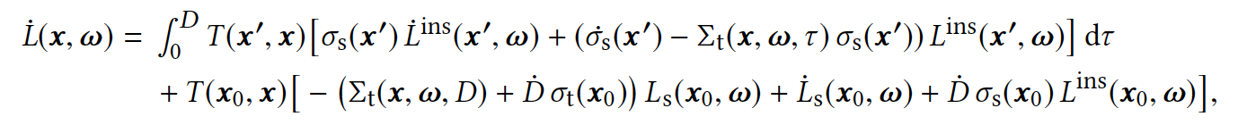
Full Radiance Derivative
This is Eq. (32) of the paper
Notes:
… here is a quick preview. Please see our paper for all the juicy equations. (pause)

Slide 20
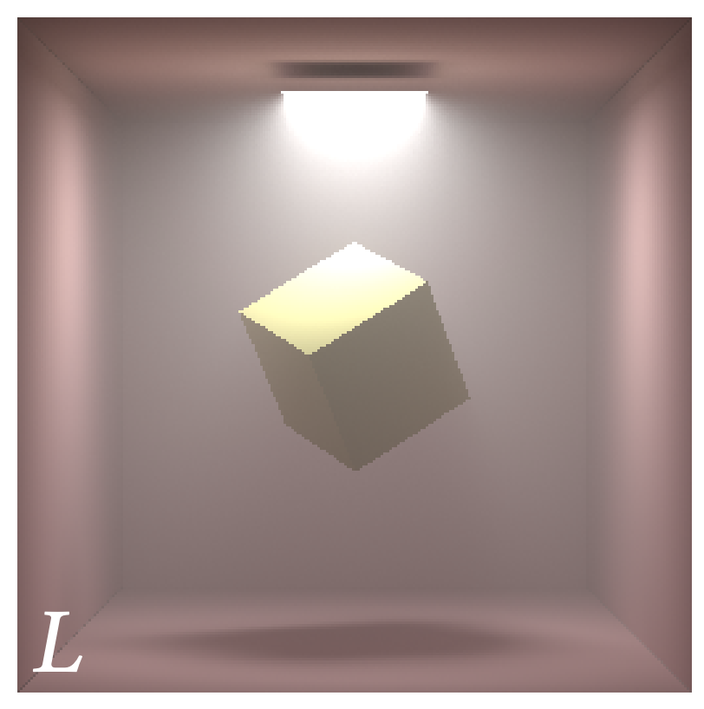
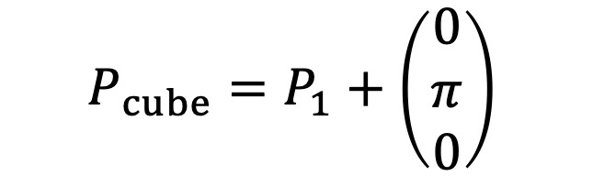

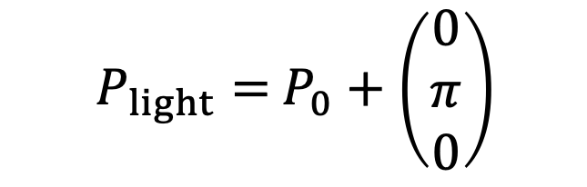
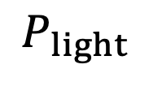

Significance of the Boundary Terms
$$y$$
$P_{light}=$ $P_{0}+\left(\begin{matrix}0 \\ π \\ 0\end{matrix}\right)$
$$P_{light}$$
$$P_{cube}$$
$$P_{cube}=P_{1}+\left(\begin{matrix}0 \\ π \\ 0\end{matrix}\right)$$
Orig. Image
Initial position
(constant)
Notes:
Before moving forward, I want to show the significance of the boundary terms.
In this example, we use a single parameter pi to control the vertical placement of both the box and the area light.

Slide 21
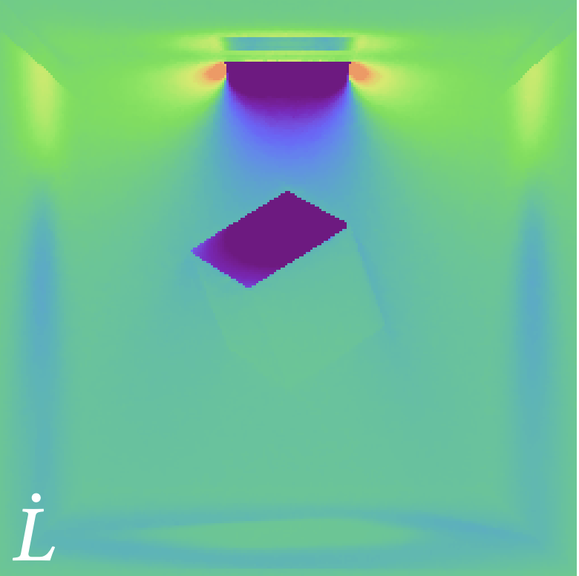
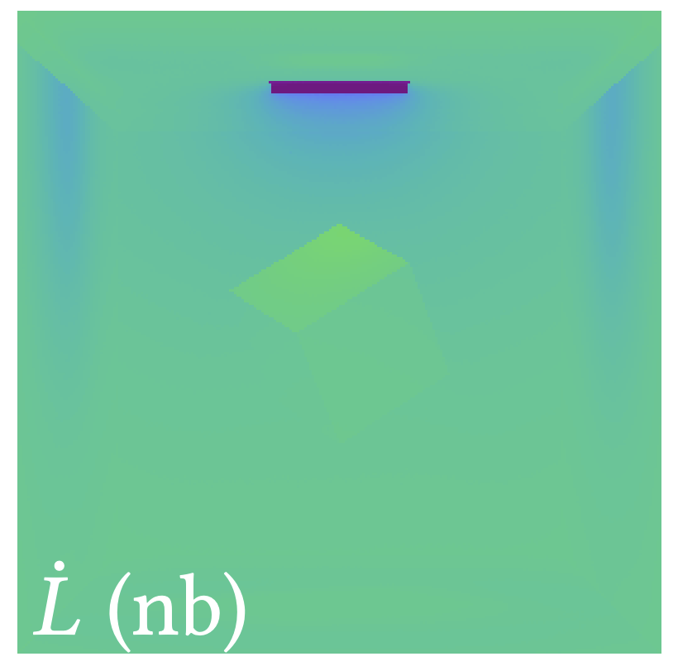
Significance of the Boundary Terms
Orig. Image
Deriv. Image
Deriv. Image
(no boundary term)
Notes:
When computing the image derivative wrt this parameter, neglecting the boundary terms leads to an incorrect result shown on the right. (click) Notice that, the derivatives on the top of the cube do not even have the right sign.

Slide 22


Differentiating the RTE: Summary
$$L=K_{T}K_{c}L+Q$$
Key:
Tracking discontinuities of integrands
Establishing boundary terms accordingly
$$∂_{π}L=∂_{π}(K_{T}K_{c}L)+∂_{π}Q$$
Notes:
To summarize, we discussed how the RTE can be differentiated. The key to proper handling of individual operators is to track integrand discontinuities and to establish the boundary integrals accordingly.

Slide 23


Differential RTE
$$L=K_{T}K_{c}L+Q$$
$$∂_{π}L=∂_{π}(K_{T}K_{c}L)+∂_{π}Q$$
Boundary terms are included
$$\left({∂_{π}L \atop L}\right)=\left(\begin{matrix}K_{T}K_{c} & K_{∗} \\ 0 & K_{T}K_{c}\end{matrix}\right)\left({∂_{π}L \atop L}\right)+\left({∂_{π}Q \atop Q}\right)$$
Differential RTE
Notes:
Based on the RTE and its differentiation, we can write the radiance and its derivatives as a coupled system governed by a new linear transport equation (click), which we call the differential RTE.
(Click) Here, the boundary terms are captured by a new K star operator.
Because of the similarity between the differential and the original RTE, Monte Carlo solutions to the original can be adapted to solve the differential RTE. Specifically, we introduce a volumetric-path-tracing-like method to estimate L and its derivatives jointly.

Slide 24











Differentiable Volumetric Path Tracing
Side Path 1
Side Path 2
$$∆L$$
$$ω_{0}$$
$$x_{0}$$
$$∆L$$
$$x_{1}$$
Component 1:
Derivative of path throughput
$$ω_{1}$$
$$∆L$$
$$x_{2}$$
Component 2:
Side paths (for estimating $∆L$)
$$ω_{2}$$
$$x_{3}$$
Notes:
This process, which we call differentiable VPT, works as follows.
Similar to unidirectional VPT, our differentiable VPT computes the average contribution of a large number of sampled light paths. In our case, the contribution of each light path includes two main components. (click) The first one is given by the derivative of path throughput, which can normally be computed using automated differentiation.
(click) The second component corresponds to the boundary terms. Estimating them requires tracing side paths at each vertex of the main light path for calculating delta L, as illustrated here.
(click) Notice that tracing the side paths requires finding visibility discontinuities, which can be expensive in complex scenes.

Slide 25
Results
Notes:
Next, we show some results.

Slide 26
Results: Validation
$$y$$
$P_{light}=$ $P_{0}+\left(\begin{matrix}0 \\ π \\ 0\end{matrix}\right)$
$$P_{light}$$
$$P_{cube}$$
$$P_{cube}=P_{1}+\left(\begin{matrix}0 \\ π \\ 0\end{matrix}\right)$$
Orig. Image
Initial position
(constant)
Notes:
We first compare derivatives computed using our method and finite difference.
Again, we are using the same cornell-box-like scene with vertical displacement of the light and box.

Slide 27

Results: Validation
Absolute difference
Finite Diff.
large spacing
small spacing
Orig. Image
Ours
(equal-time comparison)
Notes:
We can see that FD results obtained with larger spacing (click) suffer from severe bias around object boundaries. (click) On the other hand, with small spacing, the results suffer from higher noise while still being biased. This is why finite difference is known to be inefficient when combined with Monte Carlo.
(click) In comparison, our technique is capable of producing much cleaner and unbiased derivative estimations.

Slide 28
Results: Inverse Rendering
Scene configurations
participating media
changing geometry
Optimization
L2 loss for its simplicity
Any differentiable metric can be used with our method
Notes:
Now, we show some inverse rendering results using gradients estimated with our approach. All these examples involve participating media and changing geometry, making previous method inadequate.
In all these examples, we take the target image as input and search for the optimal scene parameters that minimize the L2 loss between the target and rendered image generated using these parameters.

Slide 29


Apple in a Box
Target
Optimization process
Parameters
Apple position
Cube roughness
#iterations | Time (CPU core minute per iteration)
80 | 12.2
Notes:
The first example shown here is about an apple inside a cube with absorbing medium and a rough dielectric interface. We jointly optimize the location of the apple inside the cube as well as the surface roughness of the cube itself.
The optimization process is demonstrated using an animation. The performance number is shown in the table. (click)

Slide 30


None-Line-of-Sight
Medium orientation
(param)
Heterogeneous
medium
Density scaling
(param)
Notes:
Next, we show an example where heterogeneous medium casts a colored shadow onto the ground. We optimize the orientation as well as the a density scaling factor of this medium jointly by only looking at the shadow, mimicking a non-line-of-sight imaging scenario.

Slide 31



None-Line-of-Sight
Target
Optimization process
Diff. View
#iterations | Time (CPU core minute per iteration)
60 | 7.6
Notes:
A different view is also provided here only for better understanding of the optimization process, but only the shadow view is used for solving the inverse problem.

Slide 32


Design-Inspired
Spotlight A
Parameters
Light direction
Light color
Light falloff angle
Spotlight B
Notes:
Finally, I want to show an example inspired by lighting design. In the scene, a glossy teapot within a homogeneous medium is lit by two small spotlights. We search for the orientations, colors, and falloff angles of the spotlights to match the target image.

Slide 33


Design-Inspired
Target
Optimization process
#iterations | Time (CPU core minute per iteration)
110 | 11.2
Notes:
Different from previous examples, the target image is a hand-drawn image.

Slide 34
Limitations & future work
Differentiable VPT is slow due to the need to
Computing automated differentiation
Detecting visibility changes (e.g., object silhouettes)
Tracing side paths
Estimated derivatives are noisy
Needs better sampling methods
Notes:
Our work is only a first step in differential radiative transfer, and there are many exciting future research topics.
For example, differentiable VPT can be slow and may take 10x or 20x more time compared to conventional VPT at equal samples per pixel. This is due to the overhead introduced by autodiff and, more importantly, the need to detect object silhouettes and to trace side paths. Therefore, further research is needed to improve the performance of differentiable rendering. In fact, the next paper in this very session focuses on this topic.
Also, estimated derivatives are usually noisier than the original images because of the lack of efficient sampling techniques tailored for differentiable rendering.

Slide 35
Conclusion
Differential theory of radiative transfer
Differentiating each operator of the RTE
Support differentiation wrt. arbitrary scene parameterizations
Monte Carlo estimator
Unbiased
Analogous to unidirectional path tracing
Notes:
To conclude, we introduced a differential theory of radiative transfer based on differentiating each operator of the RTE. Our theory enjoys the generality to handle a wide range of light transport effects and supports differentiation wrt arbitrary scene parameterizations.
Also, to numerically estimate the derivatives, we introduce an unbiased Monte Carlo estimator analogous to unidirectional volumetric path tracing.

Slide 36
Acknowledgment
Anonymous reviewers
Jerome Spanier
Funding
NSF grants 1717178, 1730147, 1816041, 1900849, and 1900927
NVIDIA fellowship
Ronald L. Graham Chair
UC San Diego Center for Visual Computing
Notes:
We are grateful to the anonymous reviewers and Jerome Spanier for their helpful suggestions. We would also like to thank our funding agencies.

Slide 37



Thank you
Differential radiative transfer equation (DRTE)
$$\left({∂_{π}L \atop L}\right)=\left(\begin{matrix}K_{T}K_{c} & K_{∗} \\ 0 & K_{T}K_{c}\end{matrix}\right)\left({∂_{π}L \atop L}\right)+\left({∂_{π}Q \atop Q}\right)$$
$$L=K_{T}K_{c}L+Q$$
Project Webpage
$$∂_{π}L=∂_{π}(K_{T}K_{c}L)+∂_{π}Q$$
Notes:
Thank you for your attention. We will release our implementation as well as paper latex code soon.

