Slide 1
MCMC Sampling of Visibility Boundaries for Differentiable Rendering
Peiyu XU University of California, Irvine
Sai Bangaru MIT CSAIL
Tzu-Mao Li University of California, San Diego
Shuang Zhao University of California, Irvine

Slide 2
Introduction

Slide 3
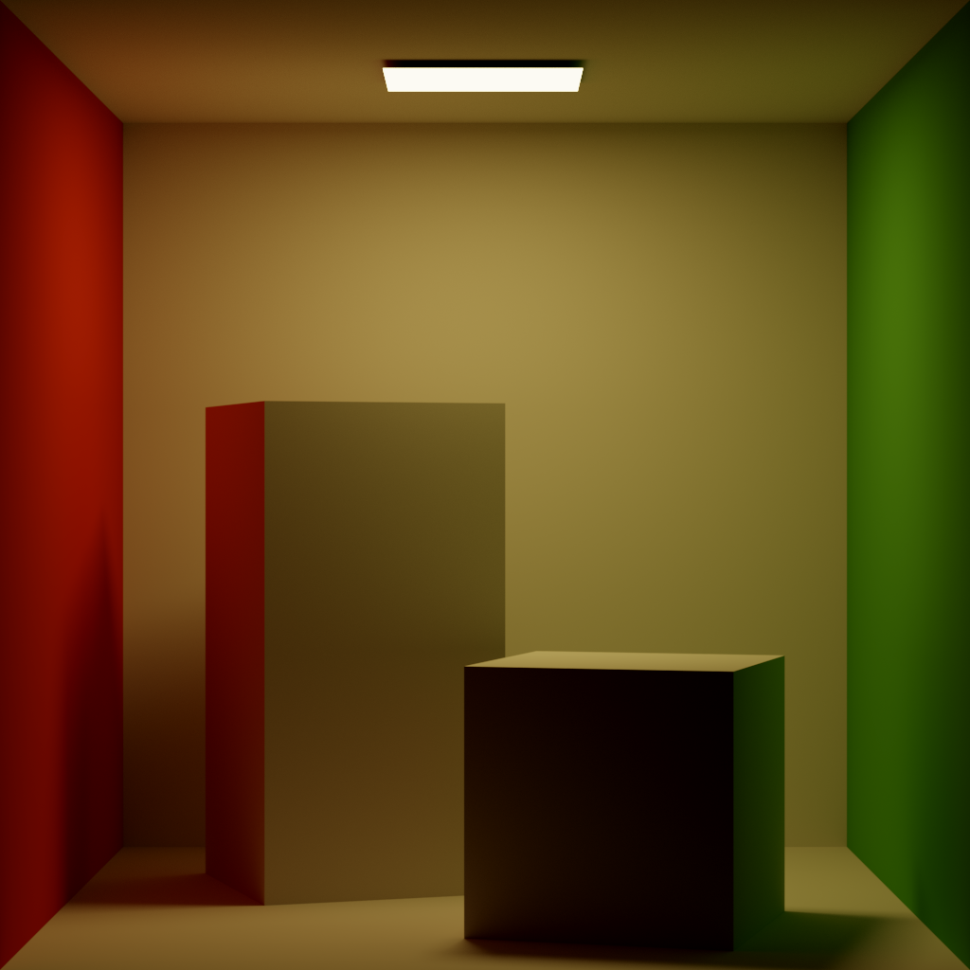
Differentiatiable Rendering
Differentiating with respect to scene geometry requires handling discontinuities
Notes:
In recent years, a large body of work has shown that differentiating with respect to scene geometry introduces discontinuities, highlighted with red lines, that require special handling.

Slide 4

Boundary Term
Light Transport:
$$I= \int{f\left(\overline{p}\right)d\overline{p}}$$
Differentiating Light Transport:
$$\frac{∂I}{∂θ}=\int{f′\left(\overline{p}\right)d\overline{p}}+\int_{Boundary}{g\left(\overline{p}\right)d\overline{p}}$$
Notes:
Mathematically, the discontinuity is handled as an additional term. This term requires us to evaluate an integral over the boundary of visibility, also highlighted in red on the right.

Slide 5
Boundary Term
Light Transport:
$$I= \int{f\left(\overline{p}\right)d\overline{p}}$$
Differentiating Light Transport:
$$\frac{∂I}{∂θ}=\int{f′\left(\overline{p}\right)d\overline{p}}+\int_{Boundary}{g\left(\overline{p}\right)d\overline{p}}$$
“Boundary Integral”
Notes:
We often refer to this integration as the boundary integral. It has been shown that, if this term is not handled correctly, the gradient would be severely biased, leading to poor optimization results.

Slide 6
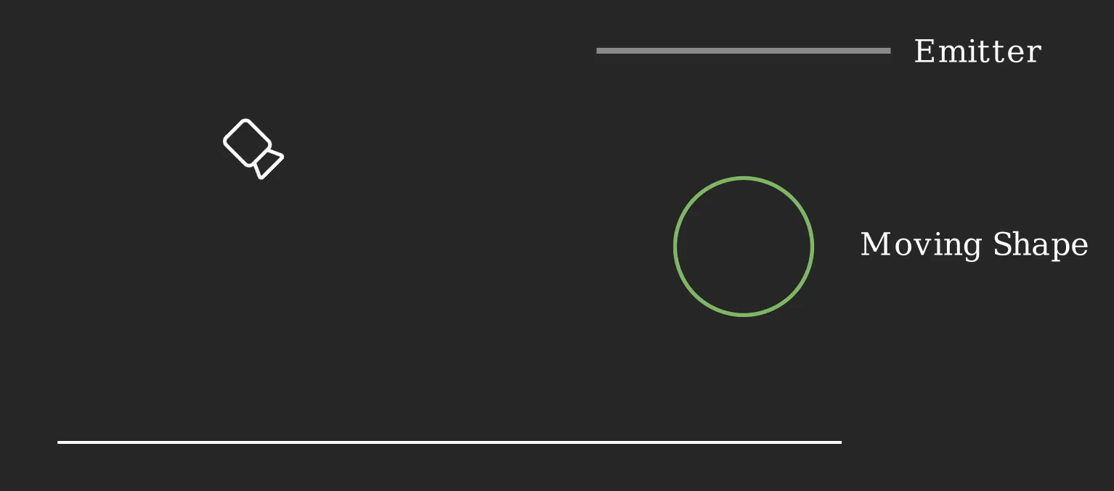
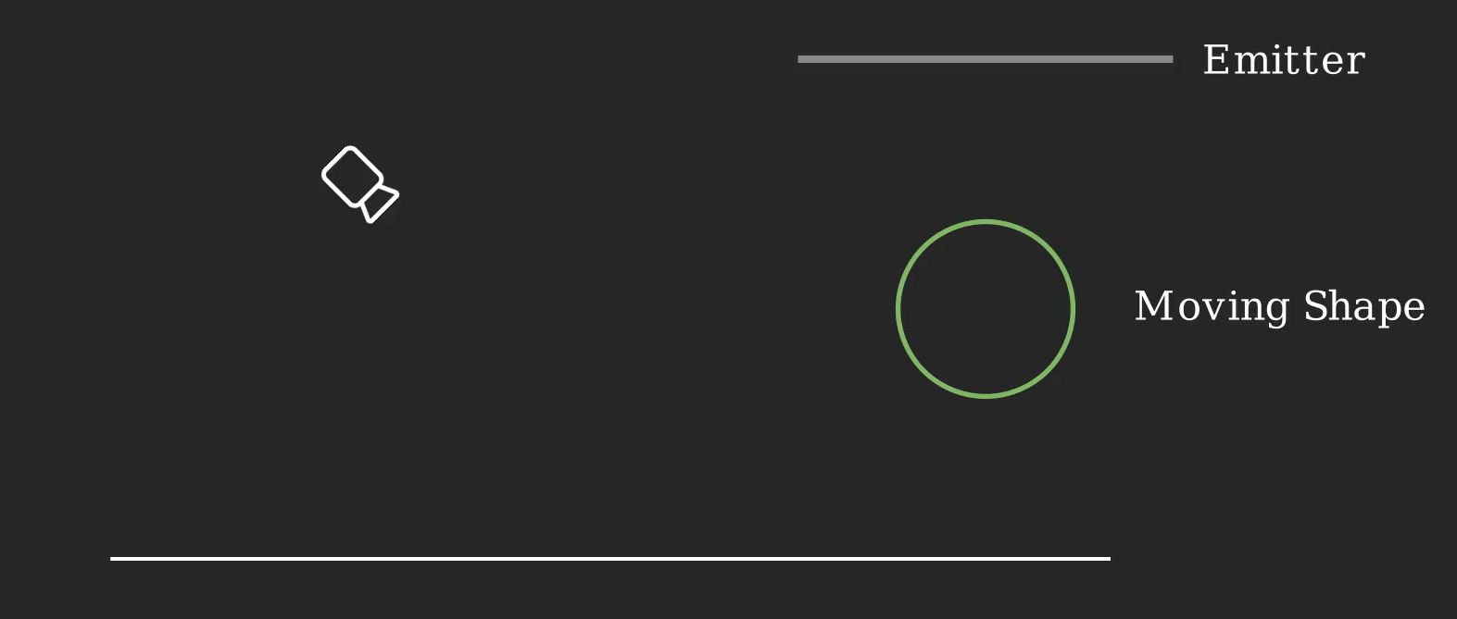
Estimating Boundary Integral
Direct estimation by sampling discontinuities
Estimation after reparameterization
Differentiable Monte Carlo Ray Tracing through Edge Sampling [Li et al., 2018]
Path-Space Differentiable Rendering [Zhang et al., 2020]
Efficient Estimation of Boundary Integrals for Path-Space Differentiable Rendering [Yan et al., 2022]
Projective Sampling for Differentiable Rendering of Geometry [Zhang et al. 2023]
Unbiased Warped-Area Sampling for Differentiable Rendering [Bangaru et al., 2020]
Warped-Area Reparameterization of Differential Path Integrals [Xu et al. 2023]
Notes:
So far, the differentiable rendering community has made a huge progress in estimating the boundary integral. Existing methods fall into two major categories. One is direct estimation by sampling discontinuities, shown on the left. This thread of work directly places samples on the discontinuities, and evaluates the boundary integral using these samples. Some previous works include …, and the state of the art is Projective Sampling proposed by Zhang et al in 2023. Another popular direction, shown on the right, is to reparametrize the boundary integral to evaluate it on a different, easier domain, which I will not go into details. Some existing works include … Our work adds another paper to the first category, direct estimation.

Slide 7
Our Contribution
Why Yet Another Boundary Handling Algorithm?
Notes:
At this point, a natural question to ask is, with all the previous works, why do we need yet another boundary handling algorithm?

Slide 8
Our Contribution
Why Yet Another Boundary Handling Algorithm?
- Efficiently sampling boundary is difficult
- We leverage MCMC to improve the efficiency for boundary sampling.
Notes:
While previous works have introduced multiple methods to improve boundary sampling, they also showed the fact that efficient boundary sampling is difficult. In the following, I will highlight some of the main reasons for such difficulties, and I will show that by leveraging MCMC, our method can improve the efficiency for boundary sampling.

Slide 9
Our Contribution
Why Yet Another Boundary Handling Algorithm?
- Efficiently sampling boundary is difficult
- We leverage MCMC to improve the efficiency for boundary sampling.
- Since our method does not rely on acceleration structure, it offers better scalability.
Notes:
And furthermore, by getting rid of the acceleration structure that previous works rely on, our method offers better scalability and robustness

Slide 10
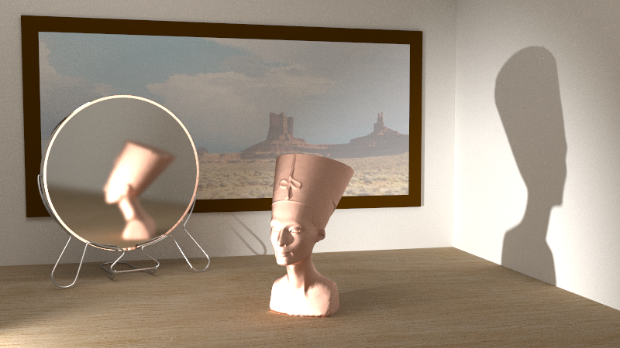
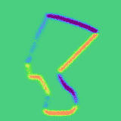
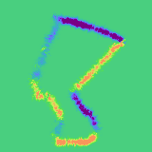
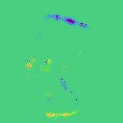
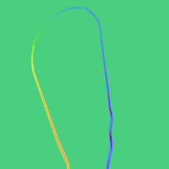
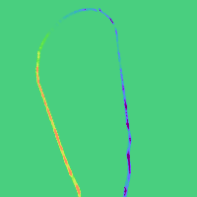

Preview of Results
(a). Primal Rendering
(b). Reference
(c). Ours
(d). Baseline
Notes:
Before I dive into the technical details, I’ll show a preview of our results. When calculating the gradient in the yellow and orange box, our method significantly outperforms the baselines

Slide 11
Boundary Path Sampling
Notes:
Now let’s start with a background introduction of boundary path sampling.

Slide 12
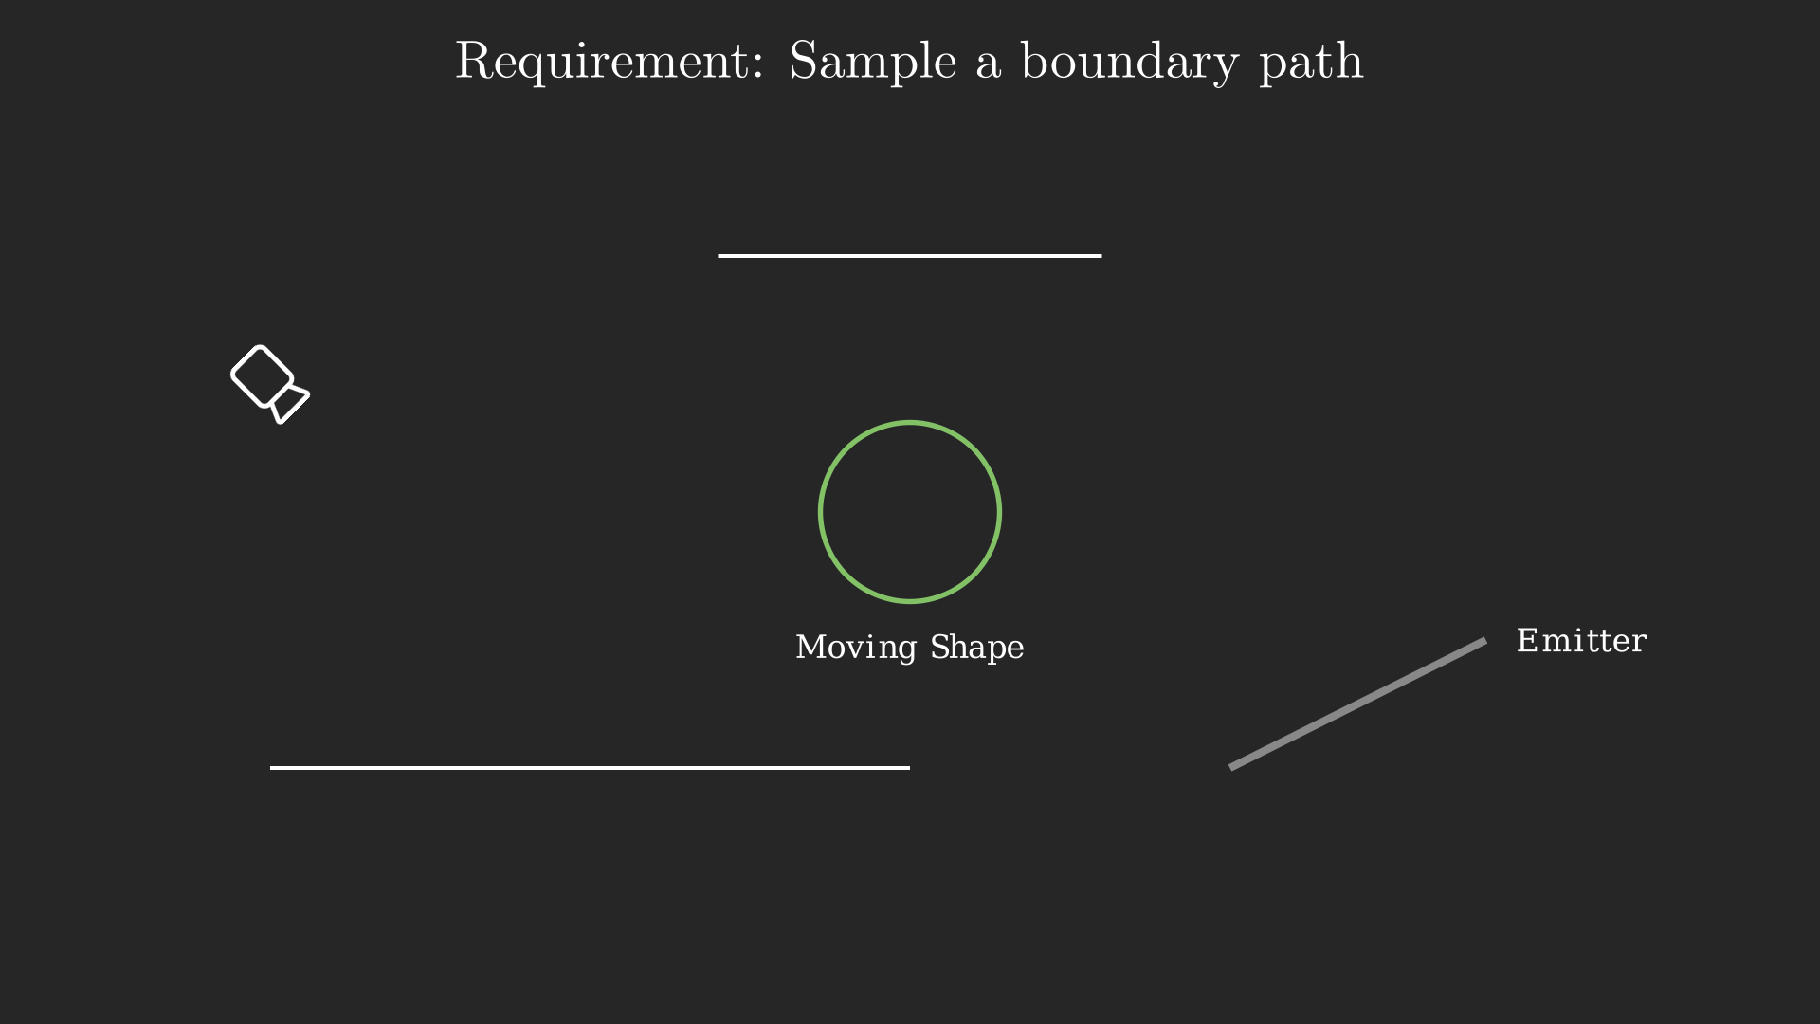
Boundary Path Sampling
Notes:
In this flatland example, we have a green sphere that is moving, introducing a discontinuity that we need to handle. This requires us to sample a boundary path.

Slide 13
Boundary Path Sampling
Notes:
A boundary path must connect the camera and the emitter [*click*],

Slide 14
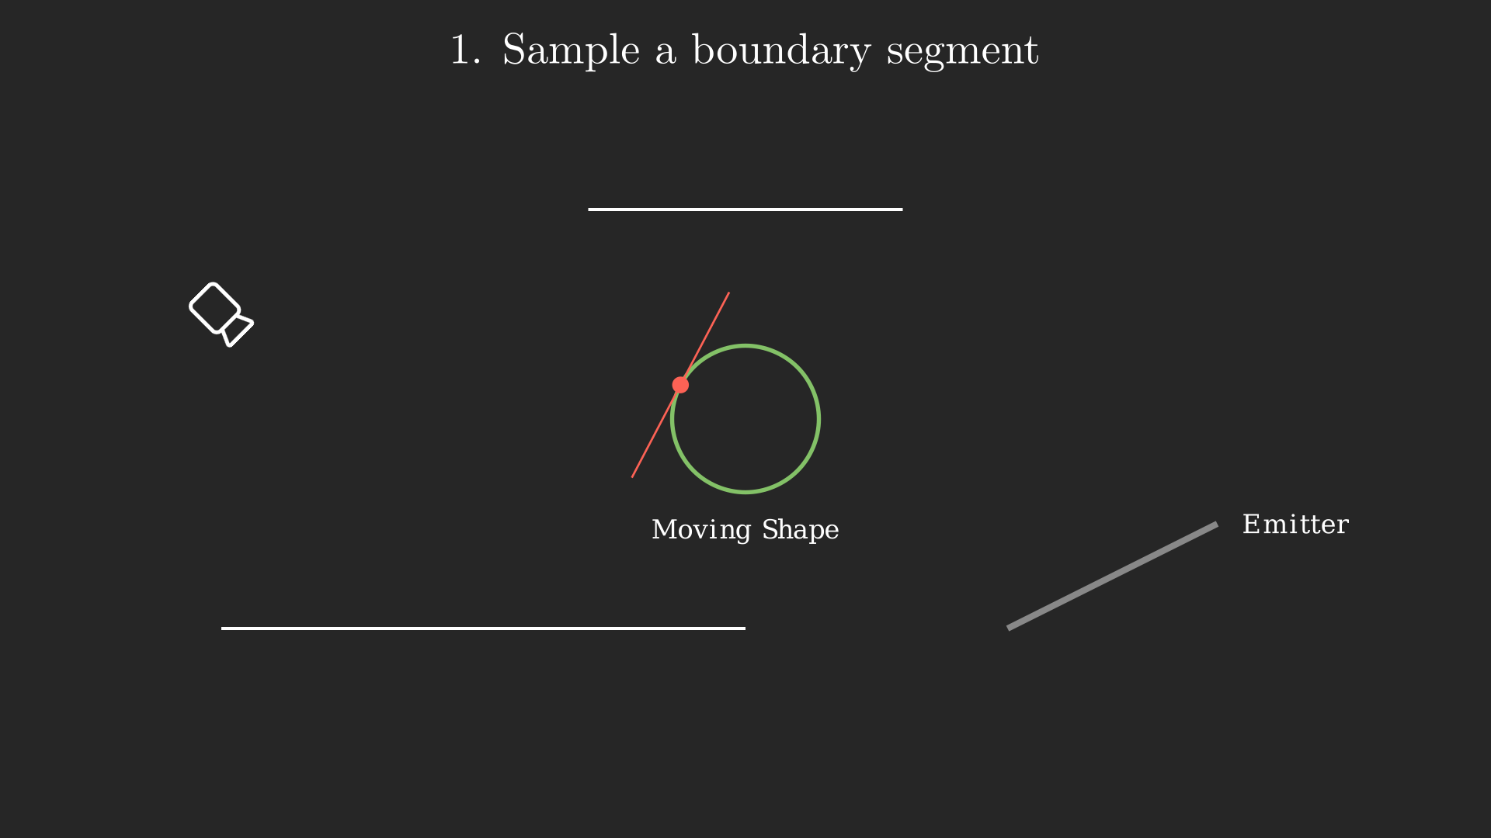
Multi-directional Sampling
Notes:
and passes the boundary of the moving shape. In order to achieve this…

Slide 15
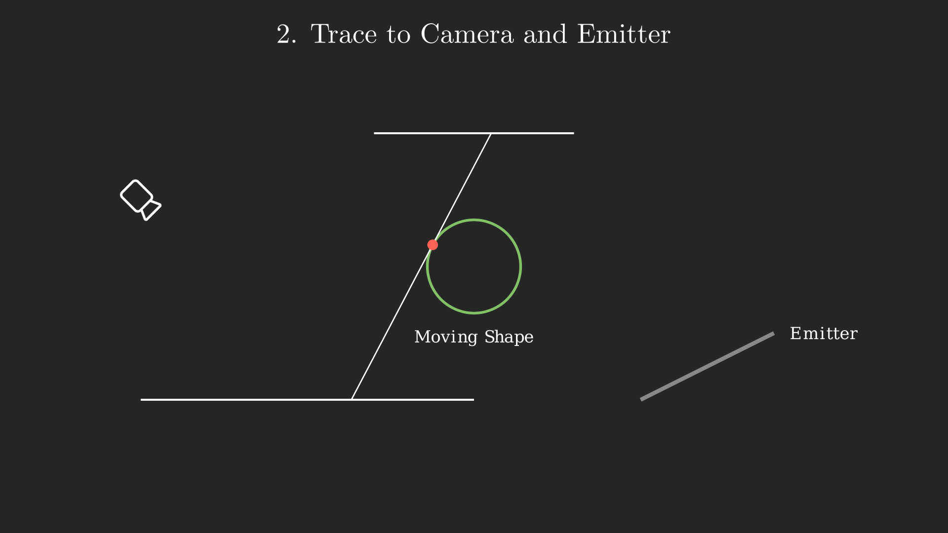
Multi-directional Sampling
Notes:
we start from sampling a boundary segment on the moving shape

Slide 16
Multi-directional Sampling
Notes:
Starting from the middle, we then use path tracing to find emitter on one side, and camera on the other side

Slide 17
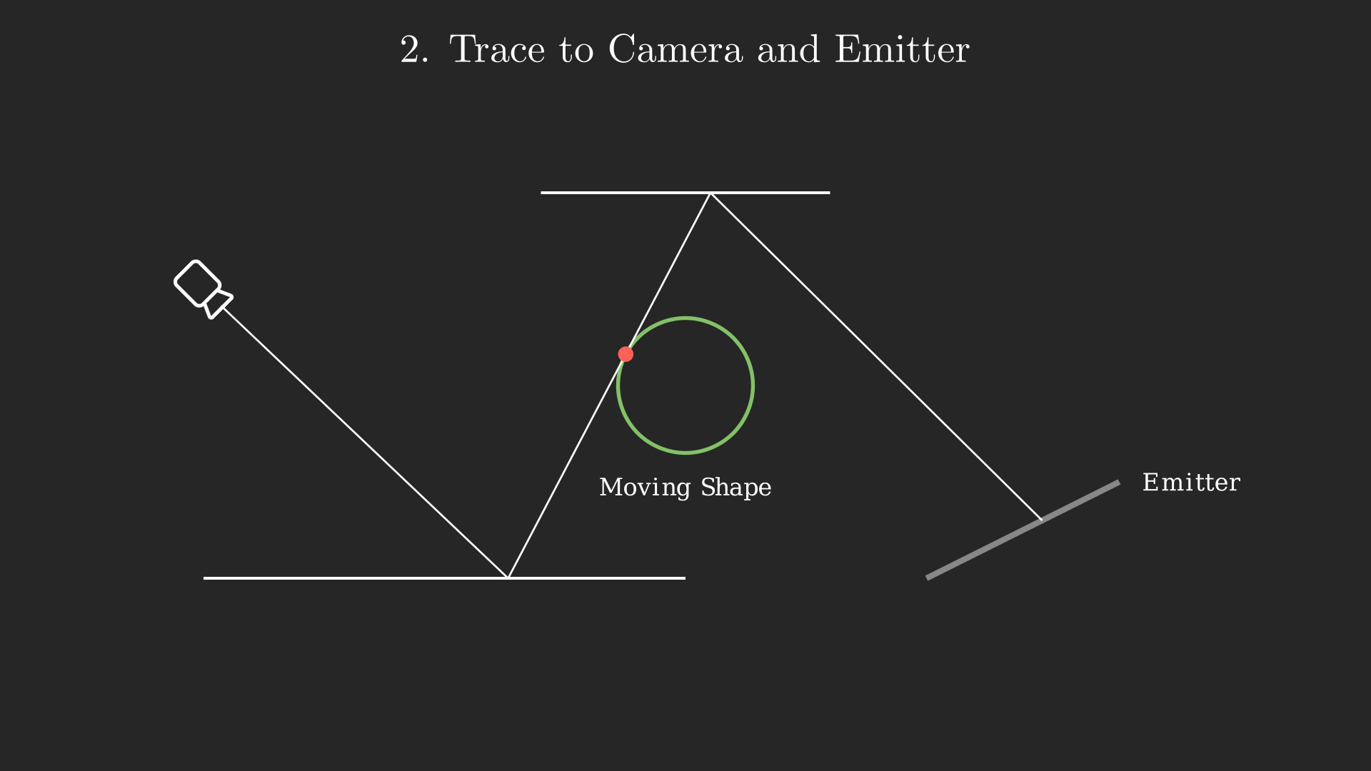
Multi-directional Sampling
Notes:
And form a full path. This path will connect the camera and the emitter, while passing by the boundary of the moving shape

Slide 18
Boundary Segment Sampling
Important operation: sampling the boundary segment.
Here lies the major difficulties of boundary handling.
Notes:
The most important operation here is sampling the boundary segment. This operation introduces some major difficulties in boundary handling that we will see later.

Slide 19
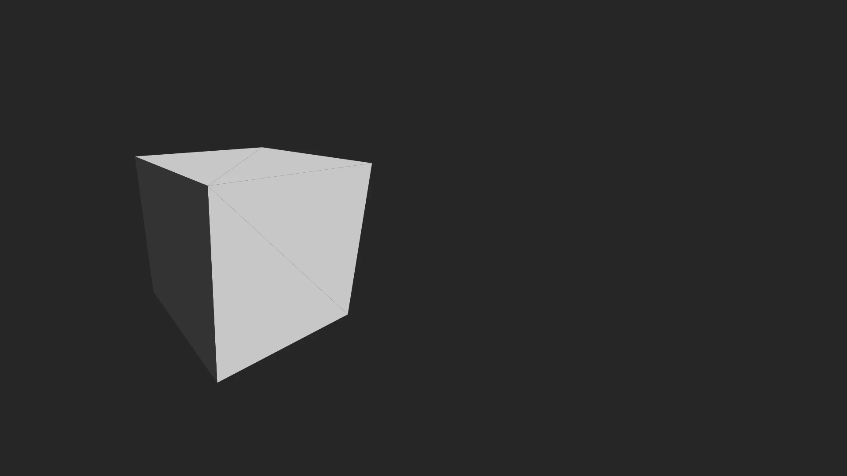
Boundary Segment Sampling [Yan et al, 2022]
Notes:
In the most commonly use method established by Yan et al, a boundary segment is sampled using 3 random variables: [*click*`]
The first random variable controls the position of a boundary point on the edges.
The second and third random variables together control the direction

Slide 20
Challenges in Boundary Segment Sampling
Critical Challenge: High contribution region is small
Notes:
A critical challenge we face in boundary segment sampling is that the high contribution region in primary sample space is often very small

Slide 21
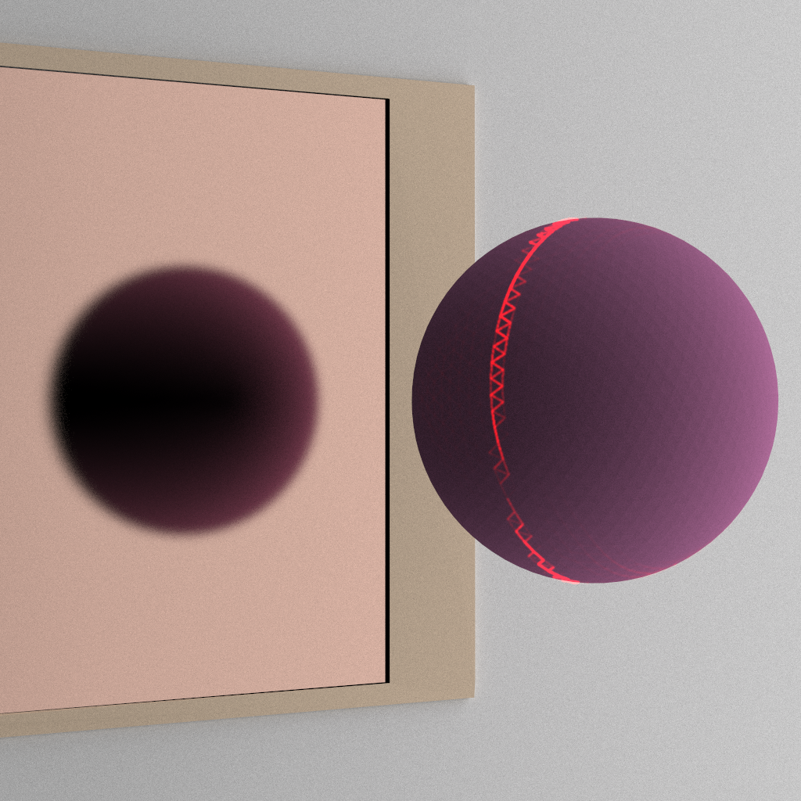
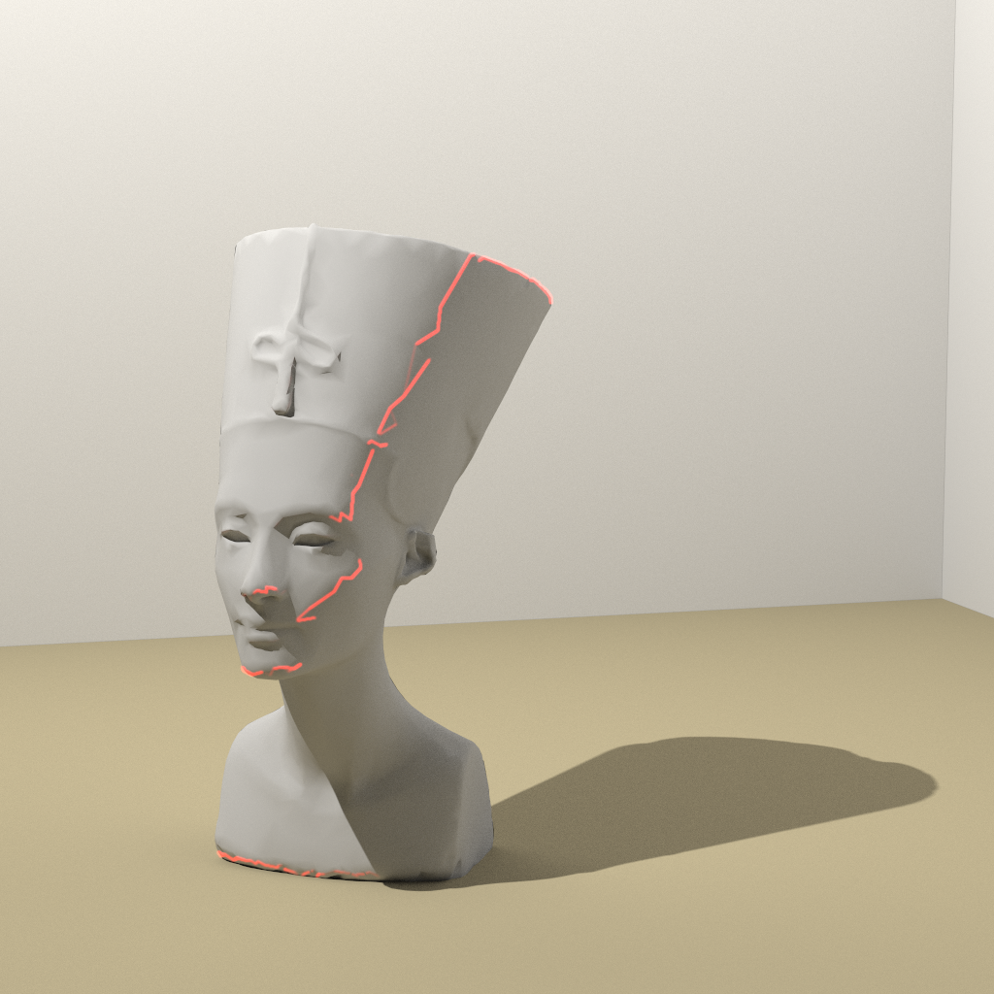
Challenges in Boundary Segment Sampling
Critical Challenge: High contribution region is small, often due to:
High Frequency BRDFs
High Frequency Emitters
Red intensity shows the edge's contribution.
Notes:
Often due to the scene containing high frequency BRDFs, and high frequency emitters. In these two examples, we color every edge based on how much it contributes to the final boundary integral. As we can observe from the graph, most edges have a near zero contribution and only a very small set of edges may be actually useful. Hence, uniformly sampling the edges would be extremely inefficient.

Slide 22
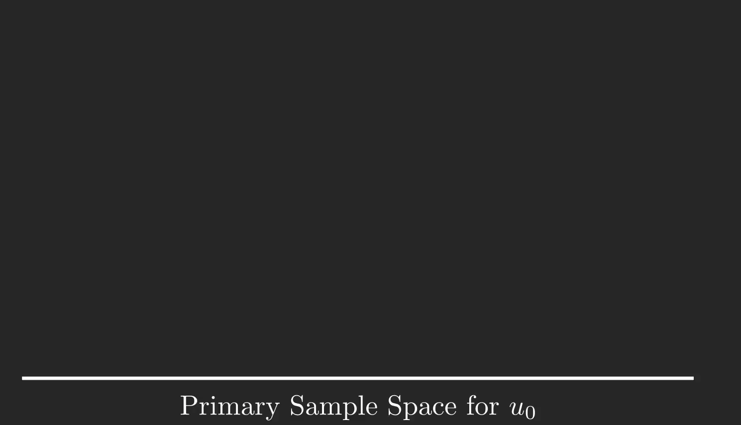
Challenges in Boundary Segment Sampling
High contribution region is highly discontinuous in PSS due to the parameterization
Notes:
Furthermore, the high contribution edges we just show becomes even more fragmented [*click*] in primary sample space. This is due to the parameterization on the boundary segment we aforementioned. As the mesh becomes more tessellated, the problem rapidly becomes more severe.

Slide 23
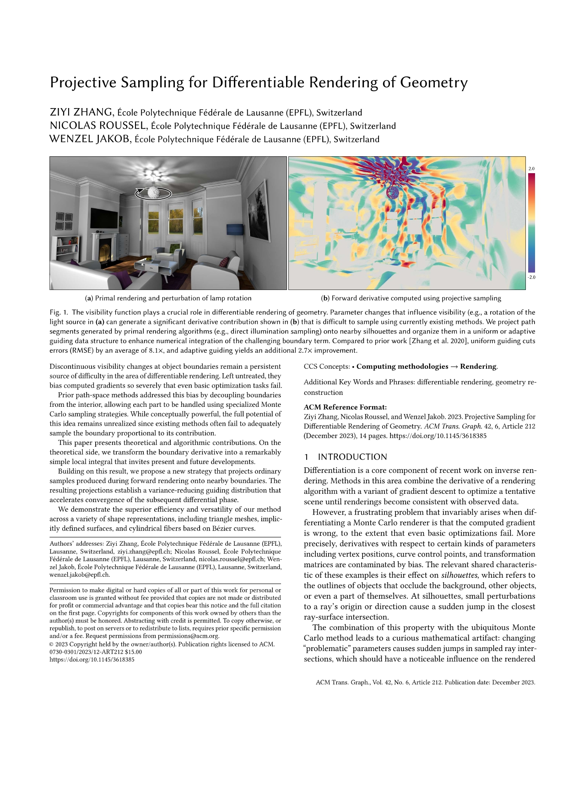
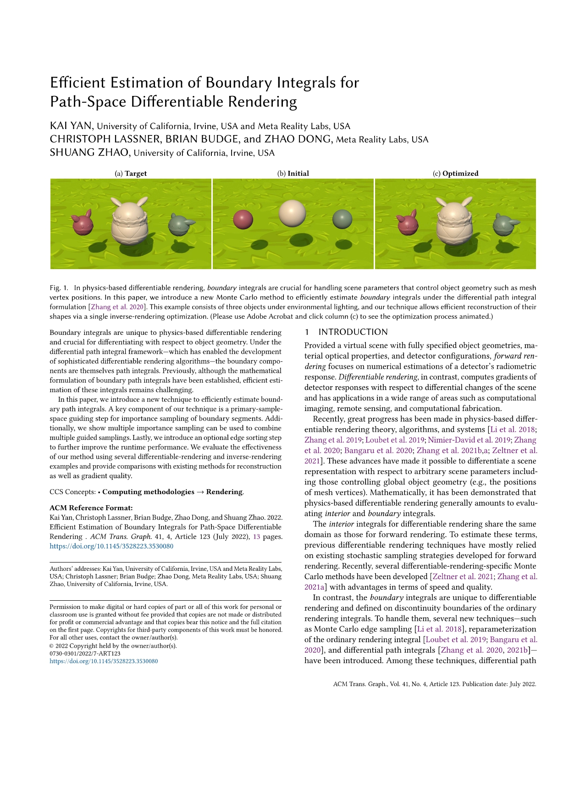
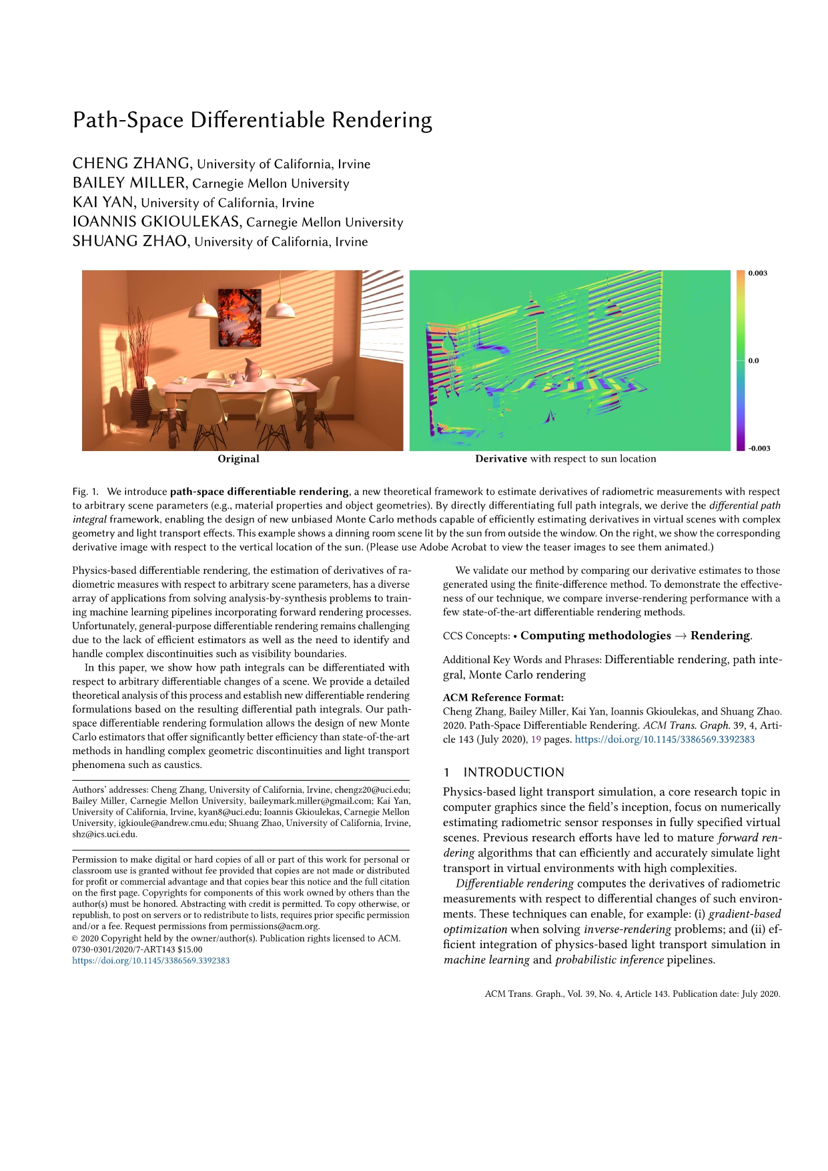
Existing Solutions: Path Guiding
+ Efficiently tracks high contribution region
Path-Space Differentiable Rendering [Zhang et al., 2020]
Efficient Estimation of Boundary Integrals for Path-Space Differentiable Rendering [Yan et al., 2022]
Projective Sampling for Differentiable Rendering of Geometry [Zhang et al. 2023]
Notes:
Existing solutions use path guiding to solve these problems. The previous works have made great progress in efficiently tracking the high contribution region.

Slide 24
Existing Solutions: Path Guiding
+ Efficiently tracks high contribution region
- Relies on acceleration structure, suffers from parameterization discontinuities
Path-Space Differentiable Rendering [Zhang et al., 2020]
Efficient Estimation of Boundary Integrals for Path-Space Differentiable Rendering [Yan et al., 2022]
Projective Sampling for Differentiable Rendering of Geometry [Zhang et al. 2023]
Notes:
However, since guiding methods rely on acceleration structures in primary sample space, they still suffer from the parameterization discontinuities. As the mesh resolution increases, the sparsity introduced by the parameterization will quickly drain the spatial resolution of the acceleration structures.

Slide 25
Our method
Our solution: Markov-Chain Monte Carlo
Notes:
In our paper, we show that Markov-Chain Monte Carlo can solve both problems, with some careful design choices.

Slide 26
Why MCMC?
MCMC can efficiently explore high contribution regions
Notes:
The motivation for using MCMC is that MCMC can efficiently explore high contribution regions, even if the regions are very small.

Slide 27
Why MCMC?
MCMC can efficiently explore high contribution regions
Important observation:
Although a well-behaved global parameterization is hard to find…
Notes:
Naively applying MCMC still doesn’t solve the parameterization problem, but here we make an important observation. Although a well-behaved global parameterization, required by path guiding, is hard to find,

Slide 28
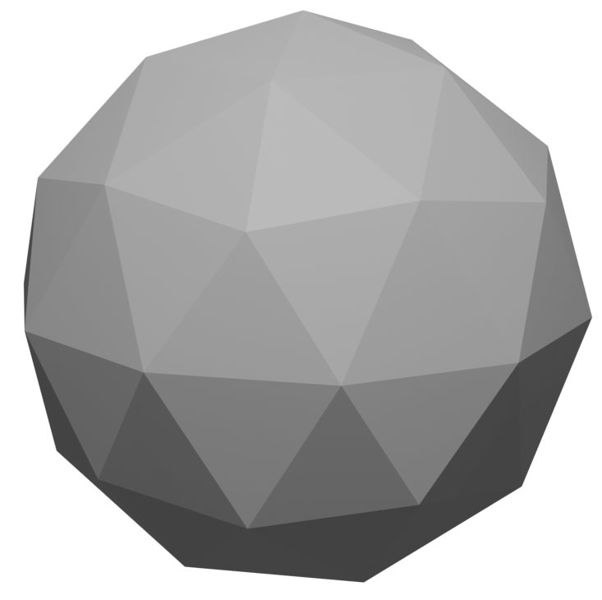



Why MCMC?
MCMC can efficiently explore high contribution regions
Important observation:
Although a well-behaved global parameterization is hard to find…
Local Perturbations can be made continuous in Path Space
$$x^{B}$$
$$E$$
$$ω^{B}$$
Notes:
The local perturbations can be made continuous in Path space. In order to understand this intuition, we can take a look at the example on the right, suppose the blue ray is the boundary segment we sampled,

Slide 29
Why MCMC?
MCMC can efficiently explore high contribution regions
Important observation:
Although a well-behaved global parameterization is hard to find…
Local Perturbations can be made continuous in Path Space
$$x^{B}$$
$$E$$
$$ω^{B}$$
Notes:
And we would like to perturb the ray in the orange direction, causing it to fall off the edge E.

Slide 30



Why MCMC?
MCMC can efficiently explore high contribution regions
Important observation:
Although a well-behaved global parameterization is hard to find…
Local Perturbations can be made continuous in Path Space
$$E′$$
$$x^{B^{′}}$$
$$E$$
$$ω^{B^{′}}$$
Notes:
In order to obtain a smooth mutation, We can simply let the ray move to an edge E prime that’s adjacent to E. So E prime is a spatial neighbor of E that we can utilize for mutation, despite that E prime could be very far away from E in the primary sample space. Querying for E prime would also be easy, since the local geometry and topology are given by the mesh.

Slide 31
Why MCMC?
MCMC can efficiently explore high contribution regions
Important observation:
Although a well-behaved global parameterization is hard to find…
Local Perturbations can be made continuous in Path Space
Helps MCMC overcome the discontinuity in PSS
$$E′$$
$$x^{B^{′}}$$
$$E$$
$$ω^{B^{′}}$$
Notes:
Therefore, by using the local geometric properties, we can help MCMC overcome the discontinuity in Primary sample space.

Slide 32

Overview of MCMC estimator
Path seeding:
Uniformly sampling from Primary Sample Space $U^{K}$
Local Perturbation:
LMC [Roberts and Tweedie 1996; Luan et al., 2020], with some improvements
Global Perturbation:
Uniformly (Re)sampling.
Notes:
With this intuition in mind, let’s look at an overview of our MCMC estimator. We uniformly sample our seed paths, and uniformly sample paths for global perturbation. We leverage LMC for local perturbation, with some improvements to overcome the sparsity.

Slide 33

Improved Local Perturbation
Discontinuities (on first dimension) occur when edge points fall off their edges
$$x^{B}$$
$$E$$
$$x^{′}$$
$$ω^{B}$$
Notes:
Taking the first dimension as an example, we identify that discontinuity only occurs when edge point falls off the edge it belongs to.

Slide 34
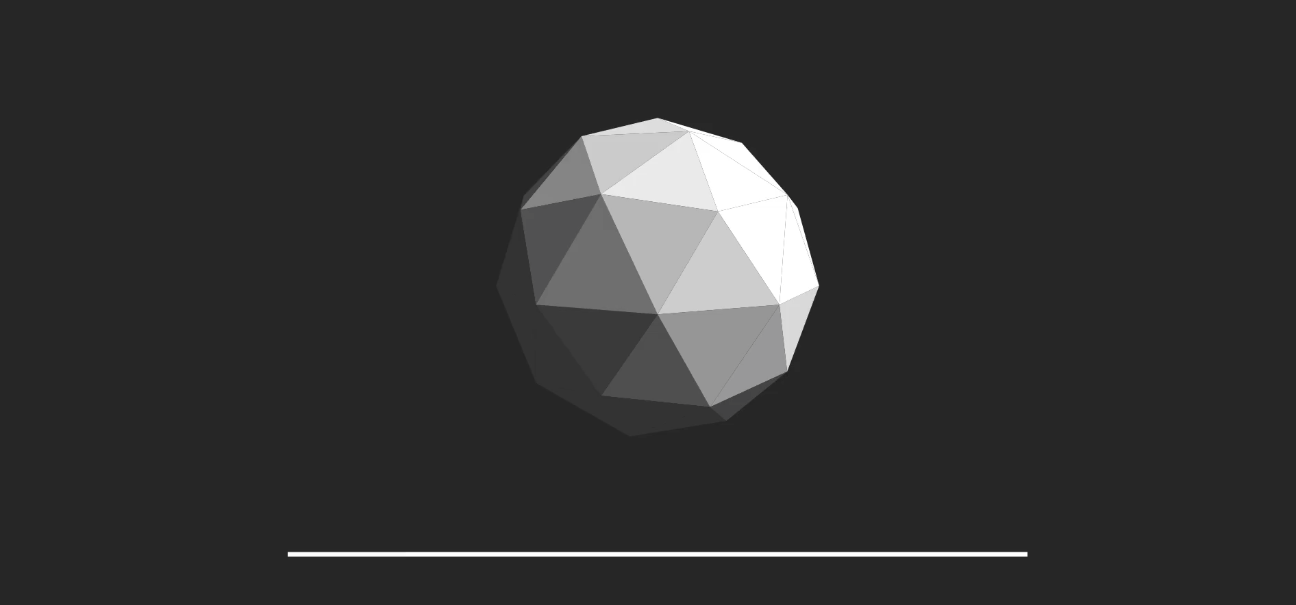
Improved Local Perturbation
Notes:
[*click*] When a mutation causes this to happen, we first find the next candidate edge for our edge point using the local geometry, move the edge point’s corresponding primary sample, and now the mutation can continue on the next edge. This process can be repeated multiple times in a single mutation step, to allow for a longer walk distance.

Slide 35
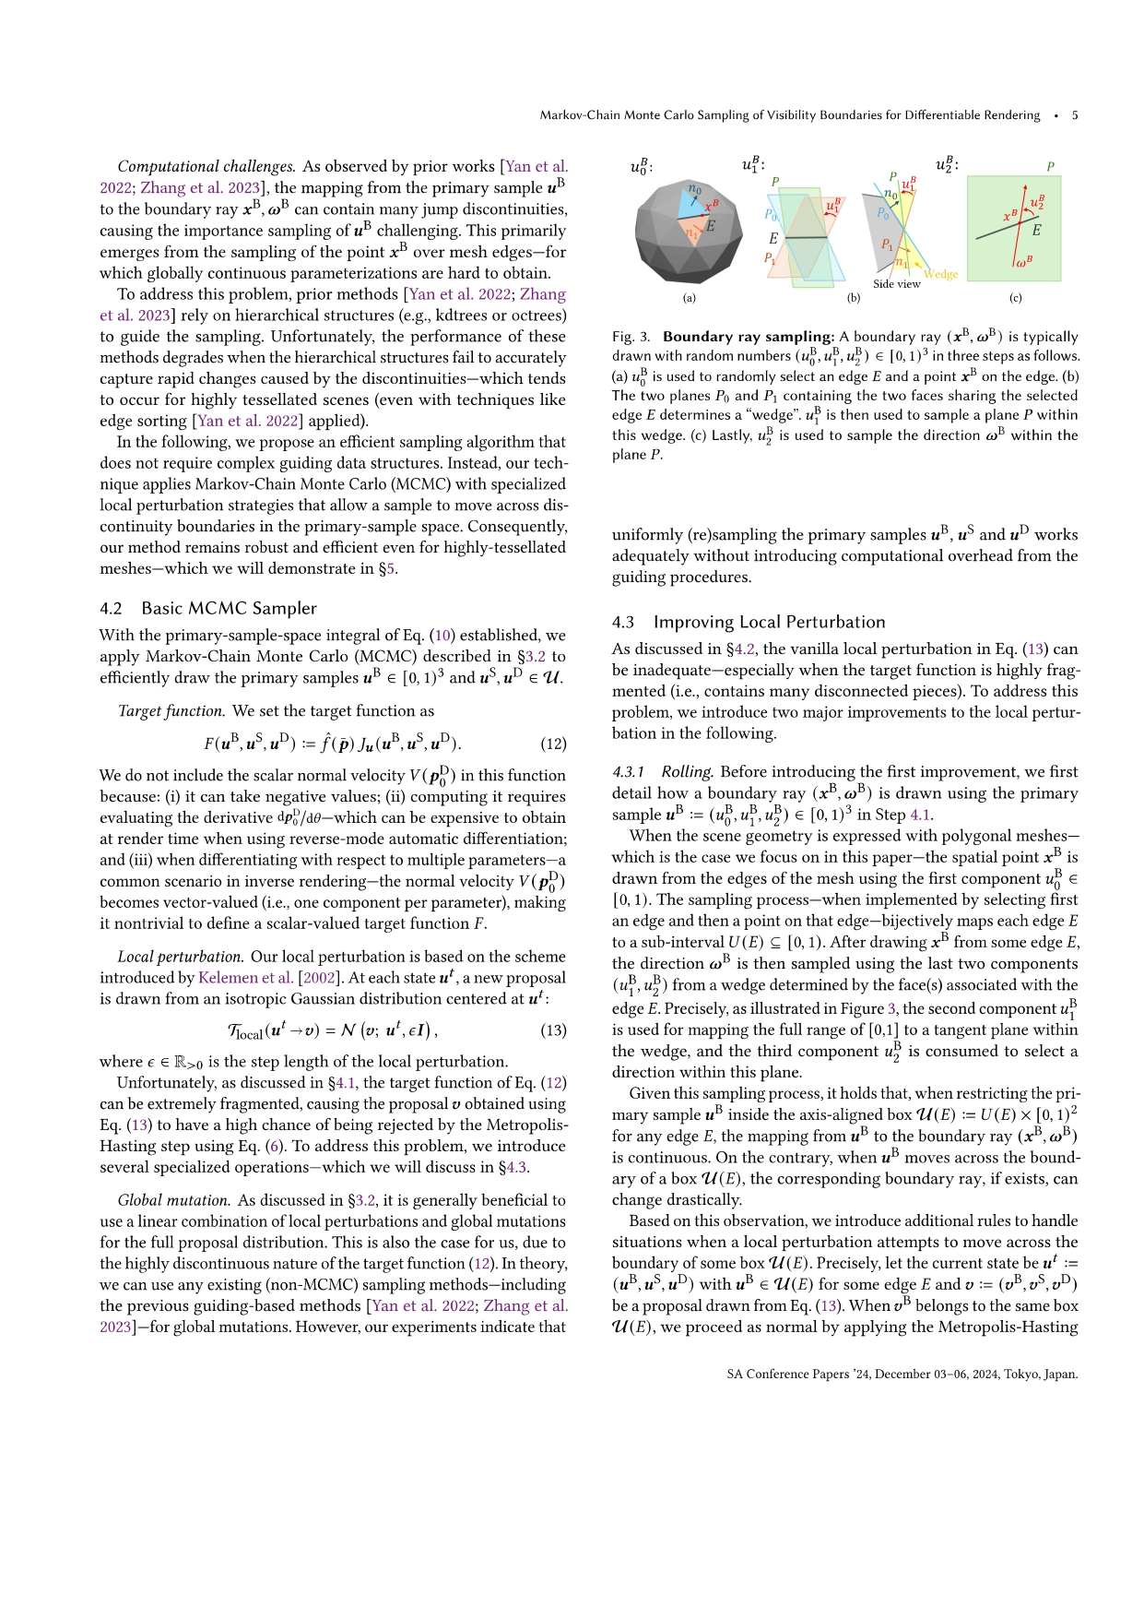
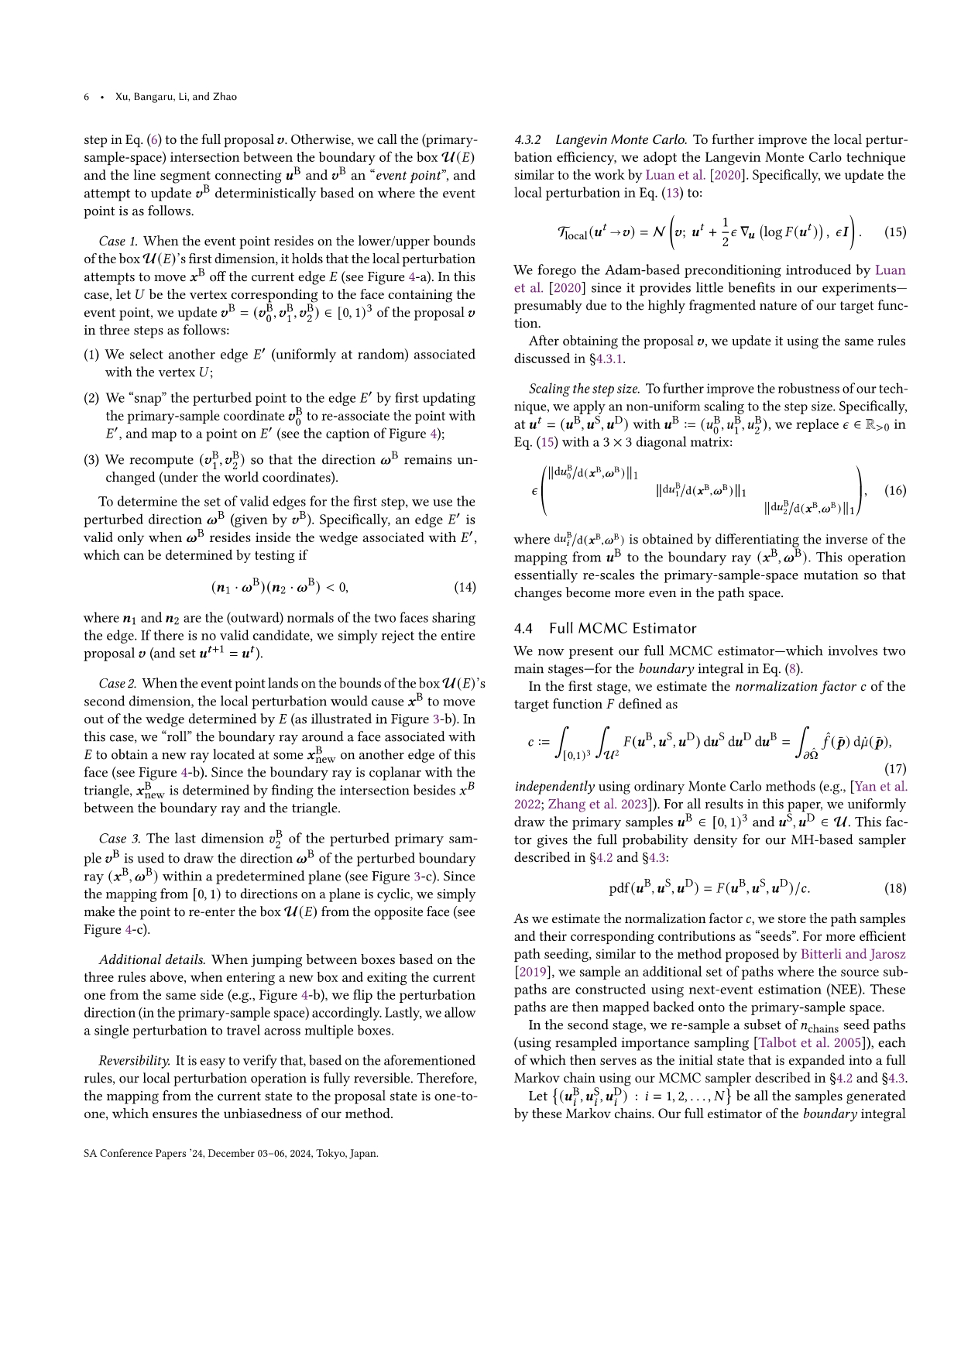
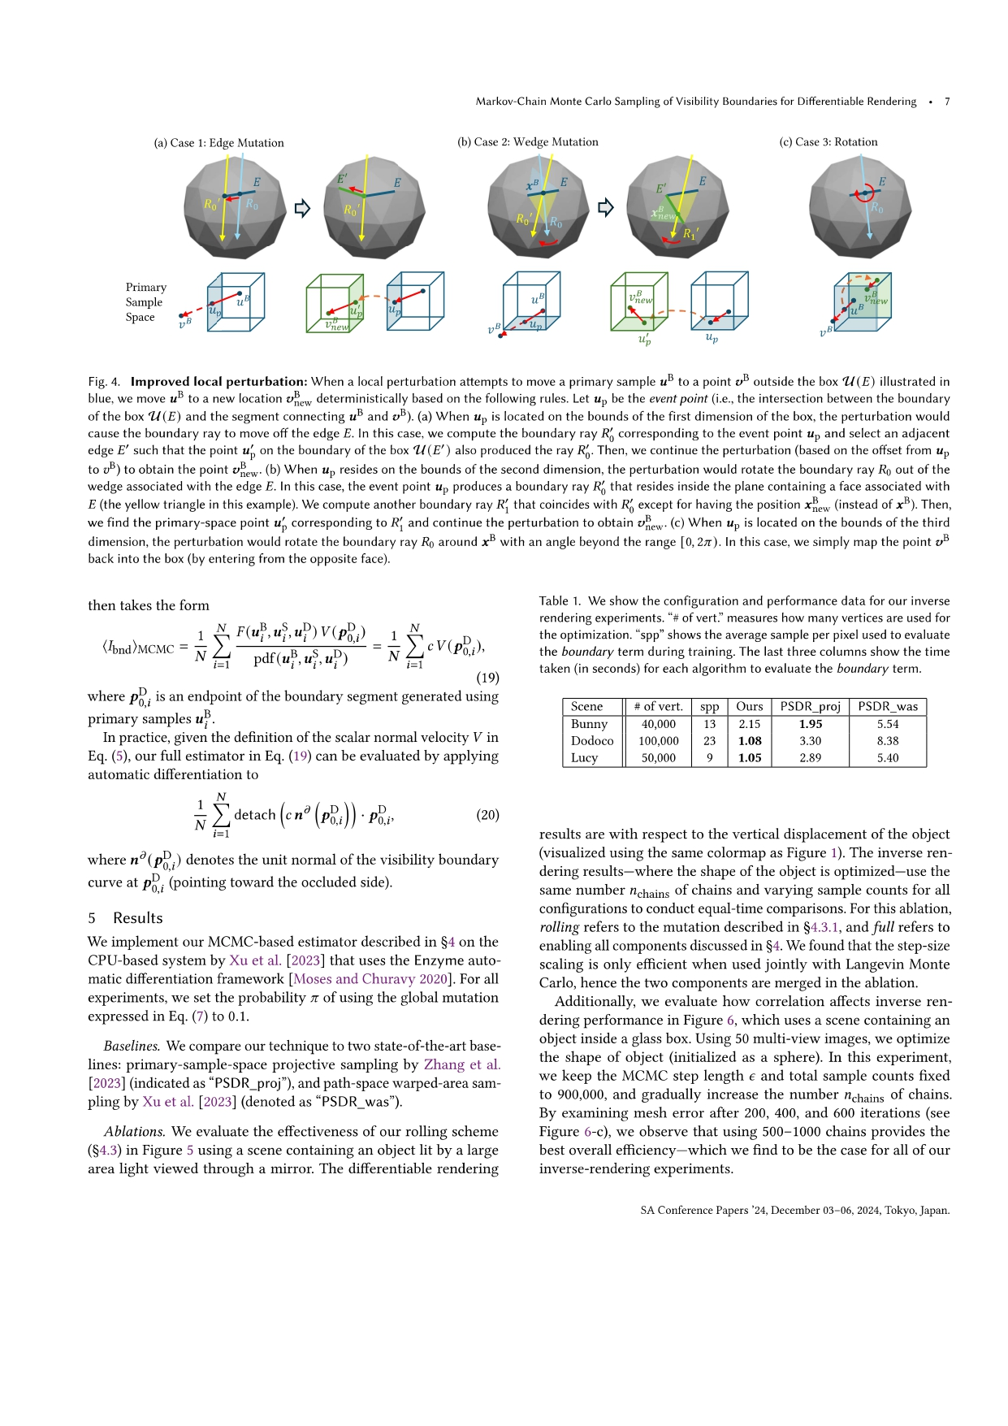
Improved Local Perturbation
We propose:
Remapping schemes for all three dimensions of PSS for boundary segment.
Additional features: LMC, Step-length Scaling
Please refer to our paper for more details
Notes:
In our paper, we show that all three dimensions for sampling boundary segment could lead to discontinuities, and we propose perturbation schemes for all three dimensions, and due to time constraint we only briefly demonstrated the first dimension here. We further introduce additional features like LMC and step-length scaling to improve the efficiency and robustness. For details of the algorithm and why we need these additional features, please refer to our paper.

Slide 36





















Improved Local Perturbation
We propose:
Remapping schemes for all three dimensions of PSS for boundary segment.
Additional features: LMC, Step size Scaling
Please refer to our paper for more details
(a) Case 1: Edge Mutation
(b) Case 2: Wedge Mutation
(c) Case 3: Rotation
$$E$$
$$E′$$
$$E$$
$$x^{B}$$
$$E$$
$$E$$
$$E$$
$$E′$$
$$R_{0}′$$
$$R_{0}$$
$$R_{0}′$$
$$R_{0}$$
$$R_{0}′$$
$$R_{0}$$
$$x_{new}^{B}$$
$$R_{1}′$$
Primary Sample
Space
$$u^{B}$$
$$u^{B}$$
$$v_{new}^{B}$$
$$v_{new}^{B}$$
$$u_{p}$$
$$u_{p}^{′}$$
$$u_{p}$$
$$u^{B}$$
$$v^{B}$$
$$v_{new}^{B}$$
$$v^{B}$$
$$u_{p}$$
$$u_{p}^{′}$$
$$u_{p}$$
$$v^{B}$$
Notes:
In our paper, we show that all three dimensions for sampling boundary segment could lead to discontinuities, and we propose perturbation schemes for all three dimensions, and due to time constraint we only briefly demonstrated the first dimension here. We further introduce additional features like LMC and stepsize scaling to improve the efficiency and robustness. Please refer to our paper for more details.

Slide 37
Results
Notes:
Next I will show some results and comparisons from our paper.

Slide 38
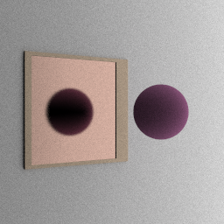

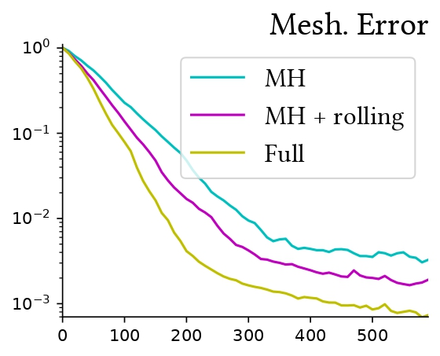
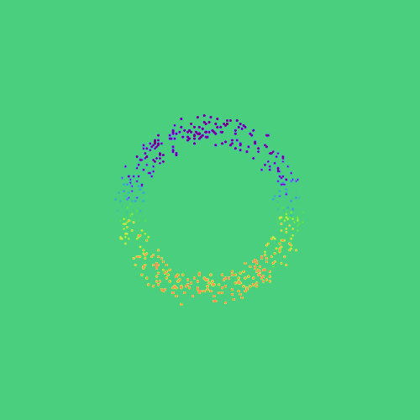
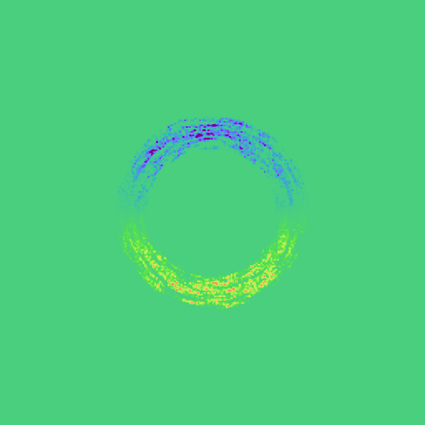
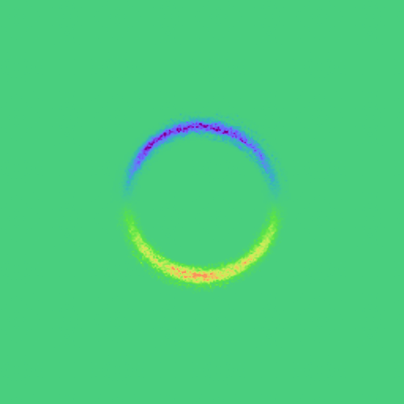
Ablation
Inverse Rendering:
Primal Rendering
Reference
MCMC +
Improved Perturb.
MCMC +
Full Features
Naïve MCMC
Notes:
In this ablation study, we render the gradient image of the camera looking at the mirror reflection of a sphere. Naively applying MCMC results in a very noisy gradient image. Our improved perturbation allows exploring more nearby edges, but the effectiveness is compromised. With our additional LMC and step-length scaling feature, the algorithm can produce a clean gradient image closely matching the reference. On the right we show the inverse rendering results. We can see that our full estimator indeed achieves fastest convergence speed.

Slide 39
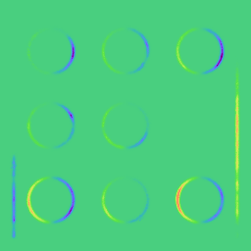
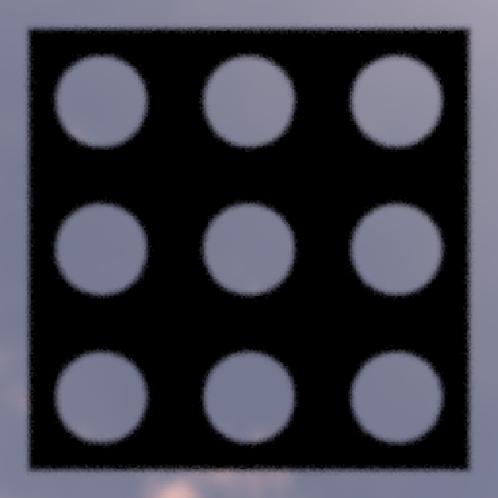
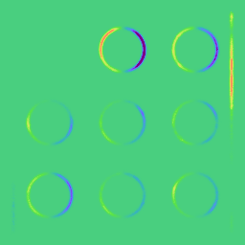
Effect of Correlation
In forward rendering:
Correlation patterns cause flickering between frames
In inverse rendering:
Correlation patterns cause flickering between iterations
Iteration 0
Iteration 1
Notes:
It is well known that when MCMC is applied to forward rendering, it introduces an unpreferable correlation pattern, causing inconsistency between frames. In inverse rendering, MCMC also introduces flickering across iterations. But in the optimization task, the flickering is in fact amortized by the optimizer. Therefore, the correlation is not a fatal problem anymore..

Slide 40
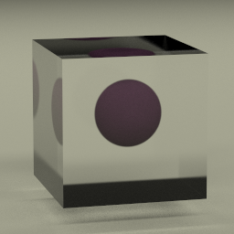
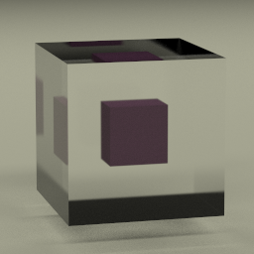
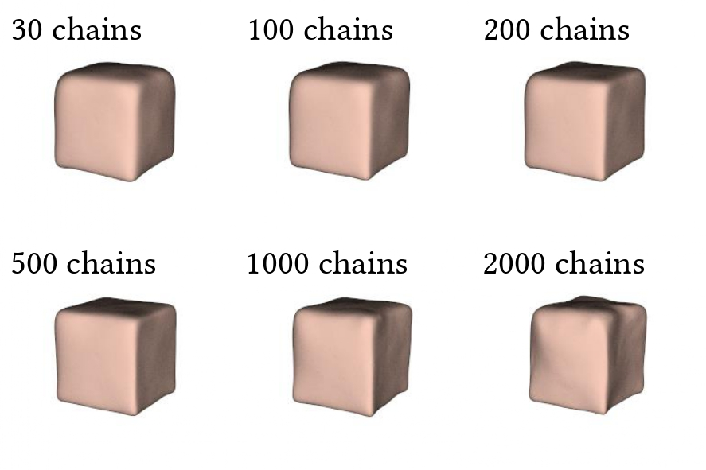
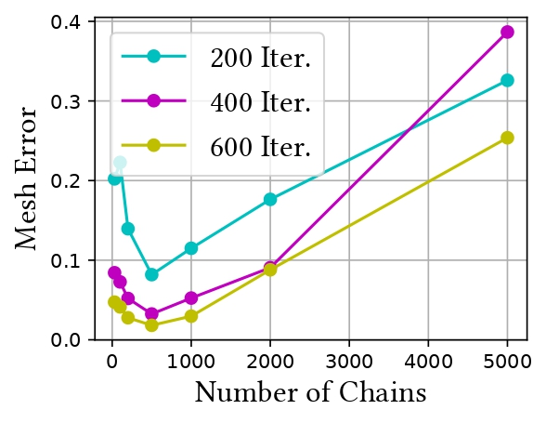
Effect of Correlation
Correlation still harms the optimization efficiency.
We control correlation-variance tradeoff by fixing the total sample count, and varying the number of chains
High correlation, Low variance is still unpreferable
Init.
Target.
Notes:
However, we do observe that autocorrelation harms the optimization efficiency. In this experiment we try to optimize the shape of an object in a glass. We control the correlation-variance tradeoff by fixing the total sample count, and varying the number of Markov chains used. From the graph we can see that when the number of chains is small and correlation is too large, although the variance is low, the convergence speed is still sub-optimal due to the high correlation.

Slide 41
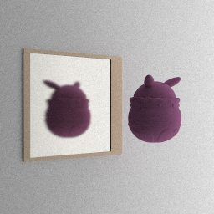
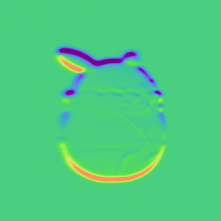
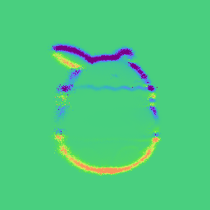
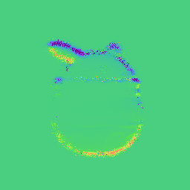
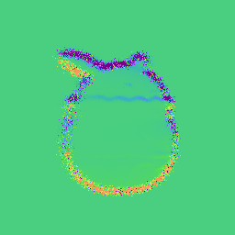
Comparisons
Primal Rendering
(Target Shape)
Reference
Ours
Projective Sampling
PathWAS
Notes:
In this experiment, we compare our method with the baselines. In differentiable rendering comparison, our algorithm produces a cleaner gradient image.

Slide 42
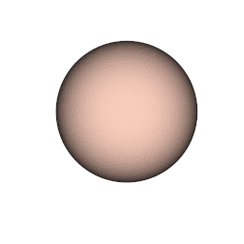
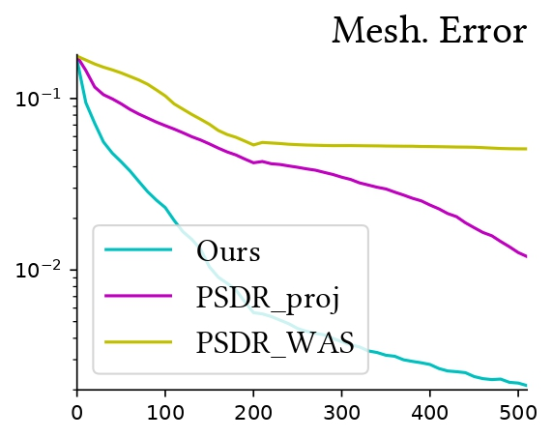
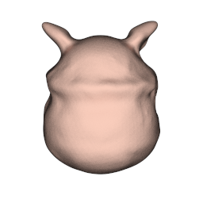
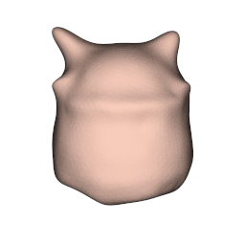
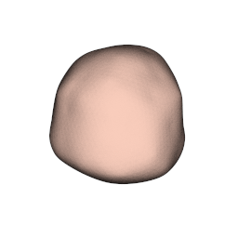
Comparisons
Inverse Rendering:
Primal Rendering
(Target Shape)
Initial Mesh
(100,000 verts)
Reference
Final Mesh:
Ours
Projective Sampling
PathWAS
Notes:
In inverse rendering we initialize the mesh with a sphere, and optimize the mesh to match the target shape. Our method also gives the highest mesh reconstruction quality, as shown by both the mesh visualization and mesh error curve.

Slide 43
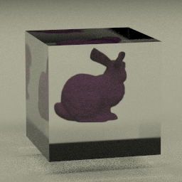
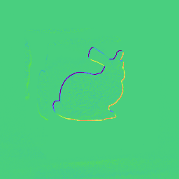
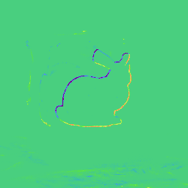


Comparisons
Primal Rendering
Reference
Ours
Projective Sampling
PathWAS
Notes:
This shows another experiment, where our method again samples the boundary path more efficiently than the baseline methods,

Slide 44





Comparisons
Inverse Rendering:
Initial Scene
(40,000 verts)
Primal Rendering
Reference
Final Mesh:
Ours
Projective Sampling
PathWAS
Notes:
In inverse rendering, our method also outperforms the baseline methods and gives the best mesh reconstruction quality.

Slide 45
Limitations and Future Works
The proposed method highly depends on topology and local geometry information.
Effect of correlation in inverse rendering needs further investigation.
We mainly investigate polygonal meshes, applying MCMC to volumetric/stochastic geometry is yet an open problem
Notes:
There are also some limitations of our method. Some of the biggest limitations are: 1. Our method highly depends on topology and local geometry. 2. Although we have taken a first step, the effect of correlation in inverse rendering needs further investigation. And a major limitation but also an interesting future direction is that we still mainly focus on discrete meshes. Applying MCMC to volumetric or stochastic geometry is still an open problem.

Slide 46

Acknowledgement
We would like to thank all the anonymous reviewers who helped improve this project.
Find out more about our project:
https://shuangz.com/projects/psdr-lmc-sa24/
Notes:
Finally, we would like to thank all the anonymous reviewers who helped significantly to improve this project. You can find out more about our project by checking out project page, or scanning this QR code. Thank you

