Slide 1
Warped-Area Reparameterization of Differential Path Integrals
Peiyu Xu, University of California, Irvine
Sai Bangaru, MIT CSAIL
Tzu-Mao Li, University of California, San Diego
Shuang Zhao, University of California, Irvine
Best Paper Award Winner!

Slide 2
Introduction

Slide 3
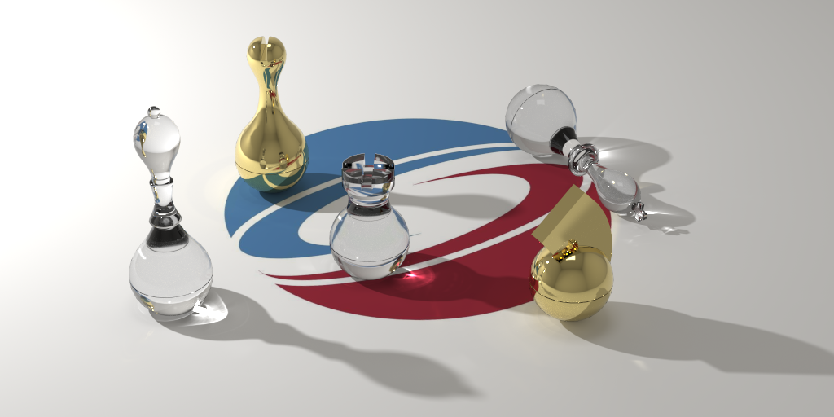
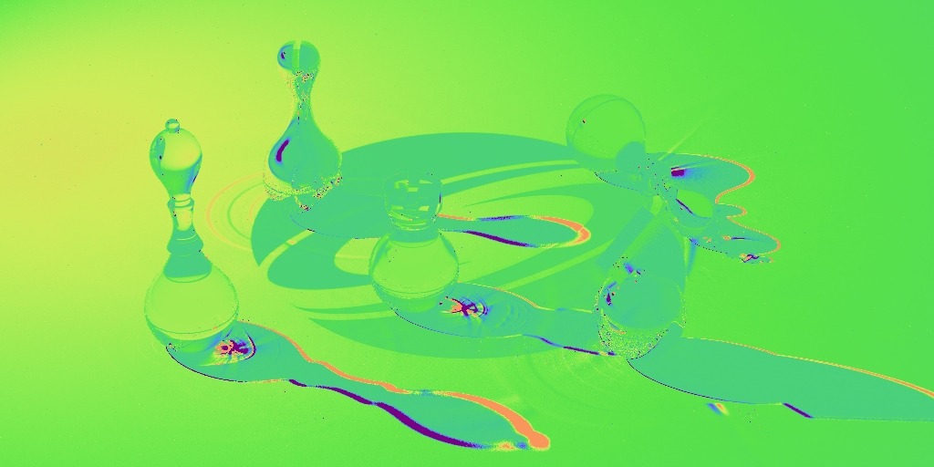


What is Differentiable Rendering?
Forward Rendering
Differentiable Rendering
$$F(θ)$$
$$\frac{∂F(θ)}{∂θ}$$
$θ$ can be any scene parameter object position, light intensity, object material, …
Notes:
Physics-based differentiable rendering is the task of numerically computing gradient of images with respect to arbitrary scene parameters such as object shape and materials. It leverages these gradients to back-propagate information, enabling the extraction of three-dimensional details from two-dimensional images."

Slide 4
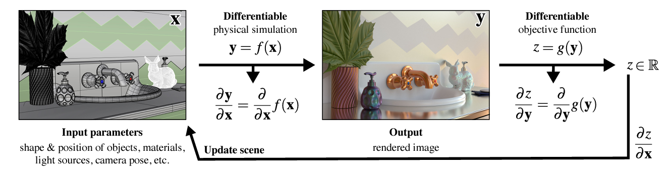
Why Differentiable Rendering
Gradient from light transport allows many applications:
Gradient-based optimization
Integrating physics into probabilistic-inferences and deep learning
Image from: Physics-Based Differentiable Rendering
A Comprehensive Introduction,
By Wenzel Jakob, Tzu-mao Li, Shuang Zhao.
Notes:
The growing trend in physics-based differentiable rendering is partly due to its ability to backpropagate through light transport equation, which unlocks a wide range of applications. Such backpropagated gradients enable gradient-based optimization such as inverse rendering, but more importantly, it also provides us with a brand new way to integrate physics into probabilistic inferences or deep learning pipelines.

Slide 5
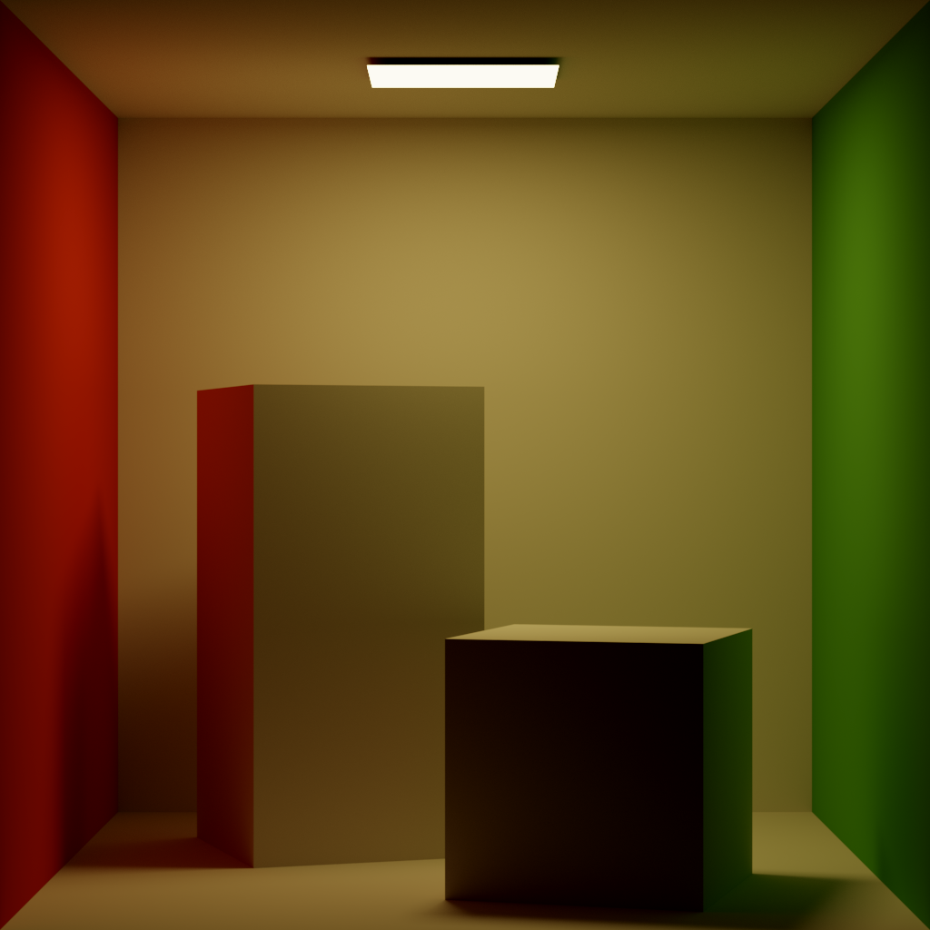
Challenges
Differentiating with respect to scene geometry requires handling discontinuities.
Discontinuities can be hard to detect/sample
Notes:
However, differentiable rendering remains a difficult problems. A key challenge in differentiable rendering is in computing derivatives with respect to object geometry. This is because such geometry affects visibility and integration domain which introduces discontinuities and will lead to severely biased gradients if not handled properly. Furthermore, such discontinuities are often hard to handle, as discontinuities in scene can be hard to detect or sample from.

Slide 6
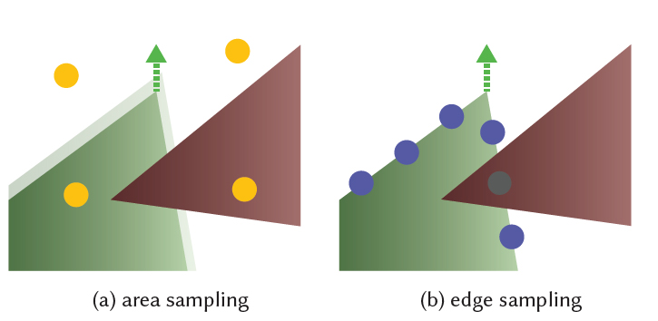
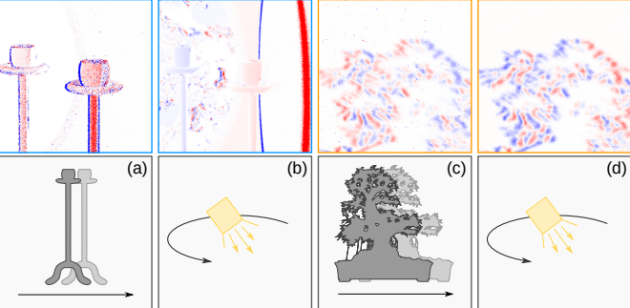
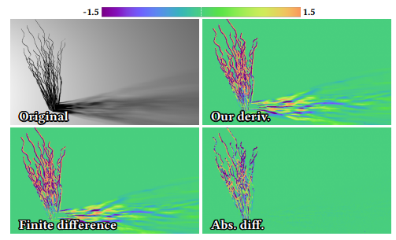
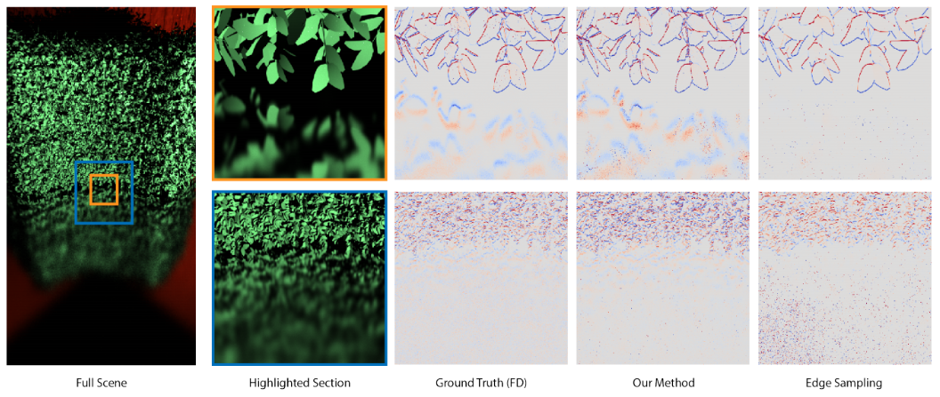
Handling Discontinuity Boundaries
Direct estimation by sampling discontinuities
State of the art:
PSDR: supports BDPT.
Non-trivial data structure for discontinuity sampling
Estimation after reparameterization
State of the art:
Warped Area Sampling: No need to explicitly handle discontinuity
Limited to unidirectional PT
Li et al. 2018
Loubet et al. 2019
…
…
Zhang et al. 2020
Bangaru et al. 2020
Notes:
So far, two categories of techniques have been proposed for handling discontinuities.
The first category explicitly samples on the discontinuities. This requires us to have sufficient knowledge on where discontinuity boundaries exists in the scene. The state of the art for this category is Physically-based Differentiabl Rendering proposed by Zhang et al. in 2020. Their work re-formulated the differential light transport equation in path space to support advanced path sampling techniques like BDPT. However, in their method, some non-trivial data structure is required for efficient sampling of discontinuity.
The second category reparametrizes the rendering integrals before estimating the integrals. Through clever designs of reparametrizations, we’re able to avoid explicit handling of discontinuities. The state of the art for this category is Warped-Area Sampling proposed by Bangaru et al. in 2020. Their method provides unbiased gradient without having to explicitly sample from discontinuities. However, their method in only derived in spherical domain, and hence is limited to unidirectional Path Tracing

Slide 7


Our Contributions
A new formulation that enjoys the benefits of both differential path integrals and warped-area reparameterization.
New Monte Carlo estimators based on the formulation
$$∂I=\int{⋅}$$
$$∂I=E[⋅]$$
Notes:
Our method falls into the second category, and we have two main contributions presented in our paper. First, we propose a new formulation that enjoys the benefits of both differential path integrals and warped-area reparameterization. Second, we designed new Monte Carlo estimators based on the formulation. The new formulation allows us to extend the second category to path space, enabling more complicated path sampling techniques such as BDPT without needing to explicitly handle discontinuities.

Slide 8
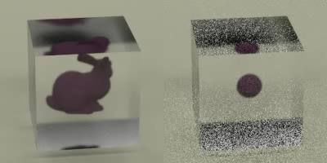
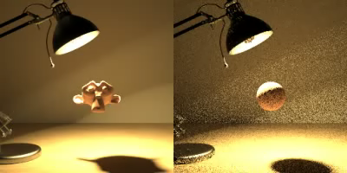
A Preview of Our Results
Ours:
Inverse Rendering
Optimization
Ours:
Inverse Rendering
Optimization
Target
Target
Notes:
Shown here is a preview of our results. The left scene shows optimizing an object inside a glass with inverse rendering, and the right side shows an object illuminated by an emitter inside a glass lightbulb. Both scenes require Bidirectional Path Tracing and involves specular objects, which makes discontinuity handling and path sampling very difficult. Our method still produces low variance gradients for reconstructing the shape.

Slide 9
Reparametrizing One-Bounce Light Transport
Notes:
We introduce our method by studying a one-bounce light transport setup. This setup will provide enough intuition to understand our method and can be easily extended to multiple-bounces.

Slide 10
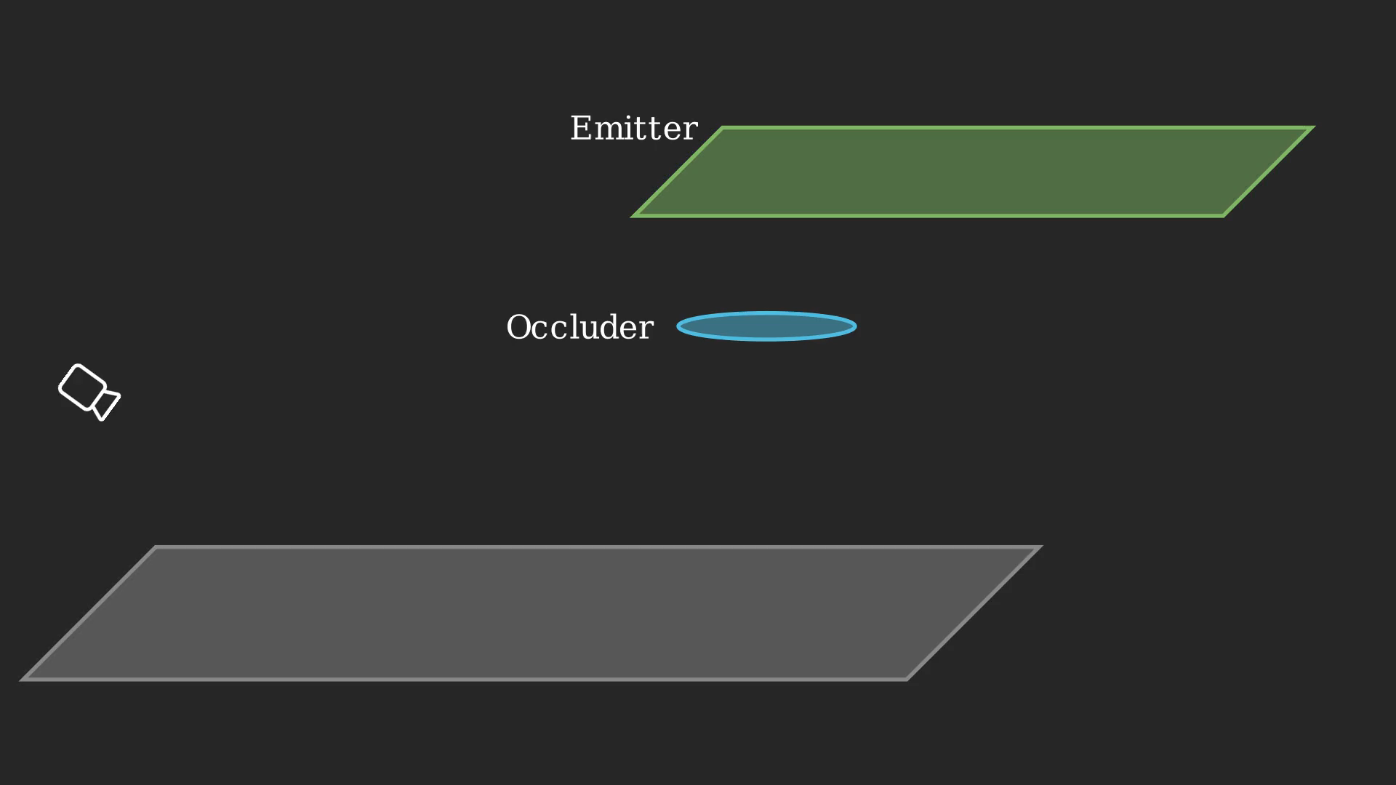

One-Bounce Light Transport Setup
Direct illumination with an occluder partly blocking the emitter
Brightness $I$of $y$: $I=\int_{Light}{L_{e}\left(x→y\right)G(x↔y)dx}$
Notes:
Let's start by considering a scene, where the camera looks at a plane that is directly illuminated by the emitter, on which we consider a single shaging point y. An occluder above the plane is partly blocking the emitter, causing the blue region on the emitter to be invisible from y. We can use the rendering equation to calculate the brightness of y, which equals to an integration over the emitter.

Slide 11
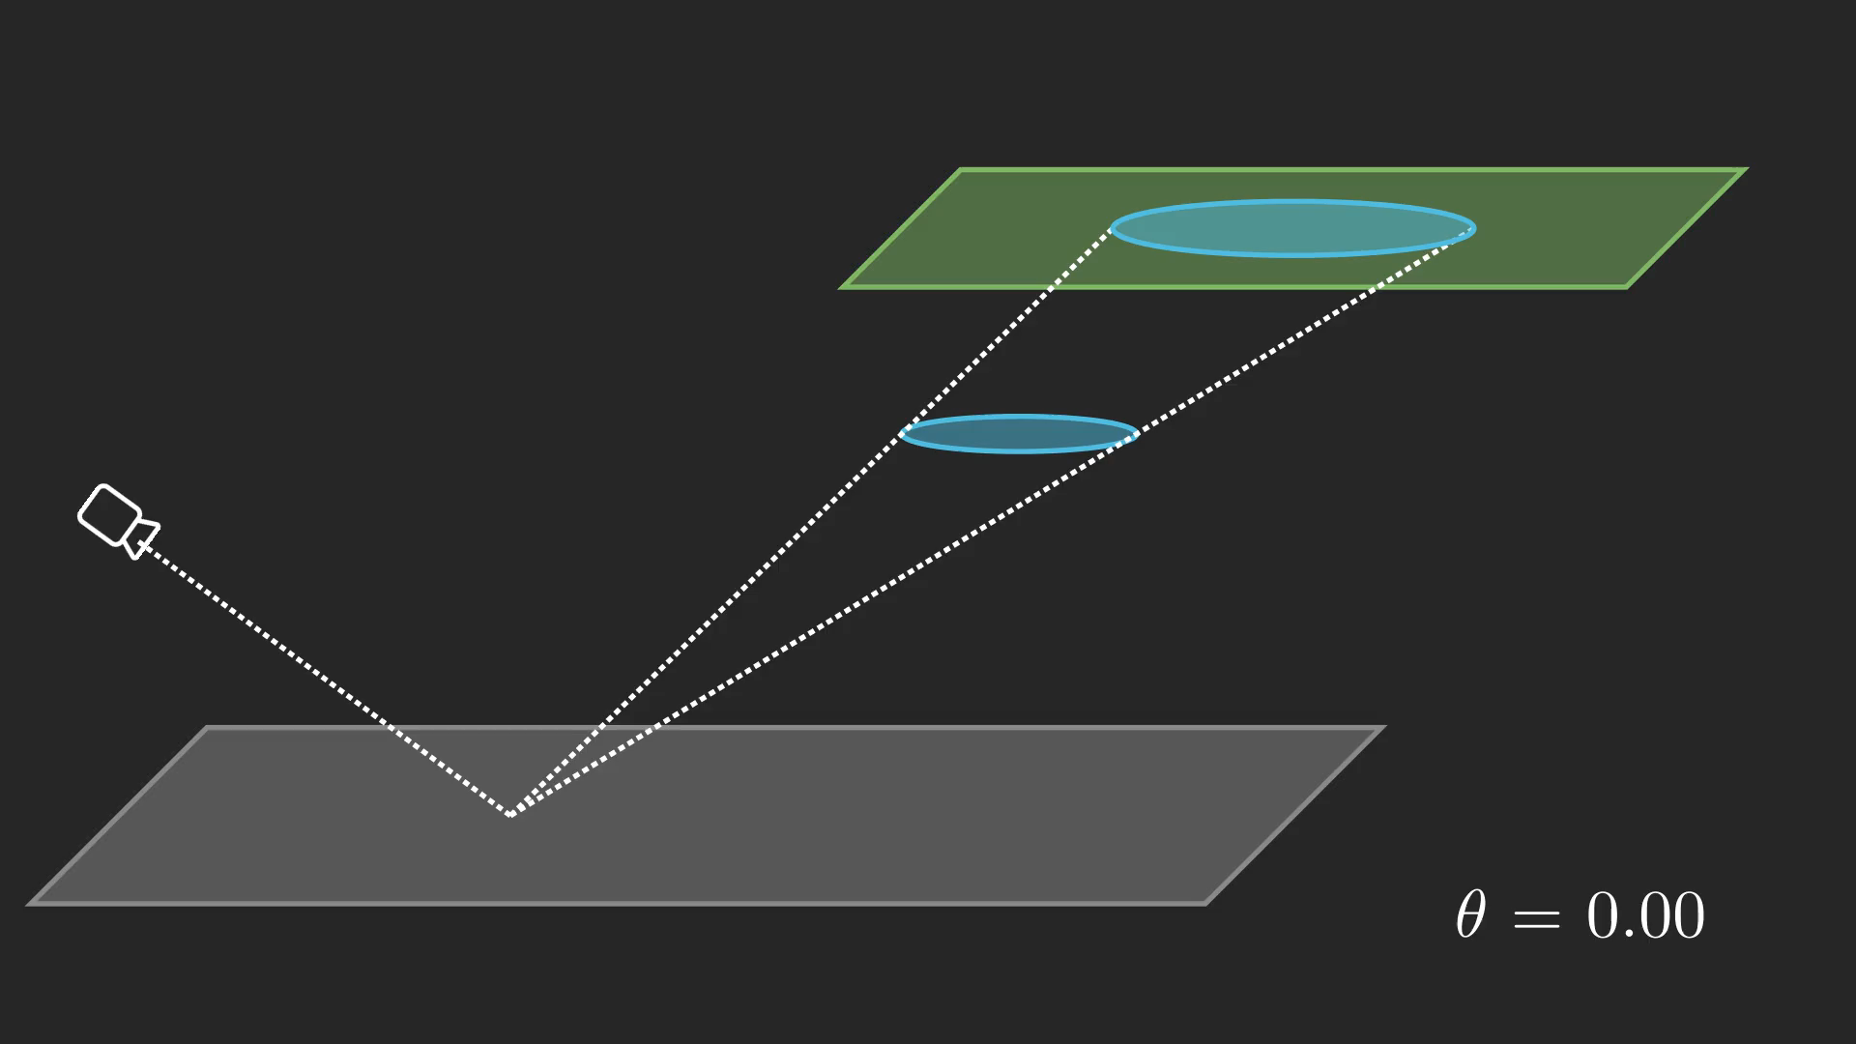

Scene Parameterization
Parameter $θ$ controls the position of emitter
$I\left(θ\right)=\int_{Light(θ)}{L_{e}\left(x→y\right)G(x↔y)dx}$
We’re interested in the derivative of the radiance: $dI/dθ$
Notes:
Now, we introduce a scene parameter theta that controls the position of the emitter. The brightness now becomes a function that depends on theta. On the right hand side, the integration domain now becomes theta-dependent. We’re interested in calculating the derivative of the radiance, namely dI/dtheta

Slide 12
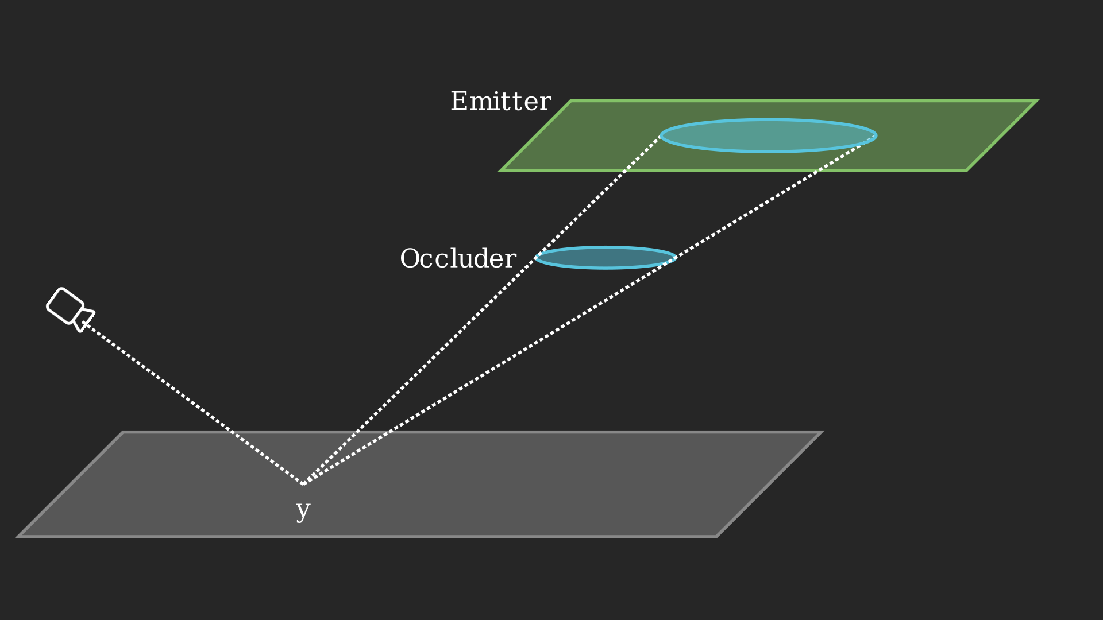


An Outline of Our Method
To obtain the derivative $dI/dθ$, we take three steps
Rewriting $I$ as an integral over a constant domain(“Material Form Reparametrization”)
Differentiating the integral from 1.
Apply Warped-Area reparametrization to handle discontinuity in 2.
$$I=\int_{Light}{L_{e}\left(x→y\right)G(x↔y)dx}$$
Notes:
In the following, we will take 3 steps to derive a differentiation of I. Firstly, we re-write I as an integral over a constant domain, as opposed to the theta-dependent domain that it is now. In step 2, we differentiate the integral that we obtained from 1. Finally, we apply warped-area reparametrization to handle the discontinuity that arises from 2. Step 1 here is what we call the material form reparametrization from prior work PSDR, and step 3 is similar to the original warped area sampling proposed by Bangaru et al. We are stacking these 2 reparametrizations to eventually derive our method.

Slide 13
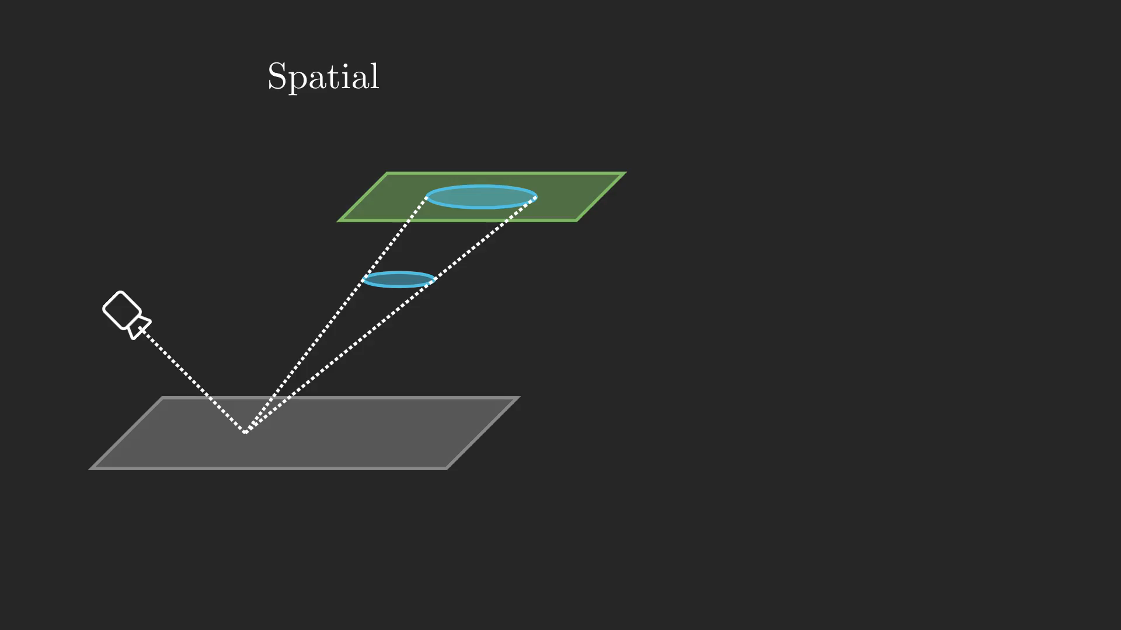


Material-form Reparameterization
Integral over a moving surface
$$I\left(θ\right)= \int_{Light(θ)}{L_{e}\left(x→y\right)G(x↔y)dx}$$
Integral over static reference domain
$$I\left(θ\right)= \int_{Ref}{L_{e}\left(x→y\right)G(x↔y)J(p, θ)dp}$$
Notes:
In step 1, we introduce the material form reparametrization. This reparametrization applies a change of variable to turn the integration over an evolving surface into an integration over a constant surface. After such reparametrization, our integration domain becomes static, or theta-independent. Furthermore, we need to introduce a jacobian term to account for the change of variable. Note that the source of discontinuity is the visibility in the geometry function, which we will handle later.

Slide 14

An Outline of Our Method
To obtain the derivative $dI/dθ$, we take three steps
Rewriting $I$ as an integral over a constant “reference” surface (“Material Form Reparametrization”)
Differentiating the integral from 1.
Apply Warped-Area reparametrization to handle discontinuity in 2.
$$I=\int_{Light}{L_{e}\left(x→y\right)G(x↔y)dx}$$
Notes:
In step 2, we differentiate the integral that we obtained in 1.

Slide 15
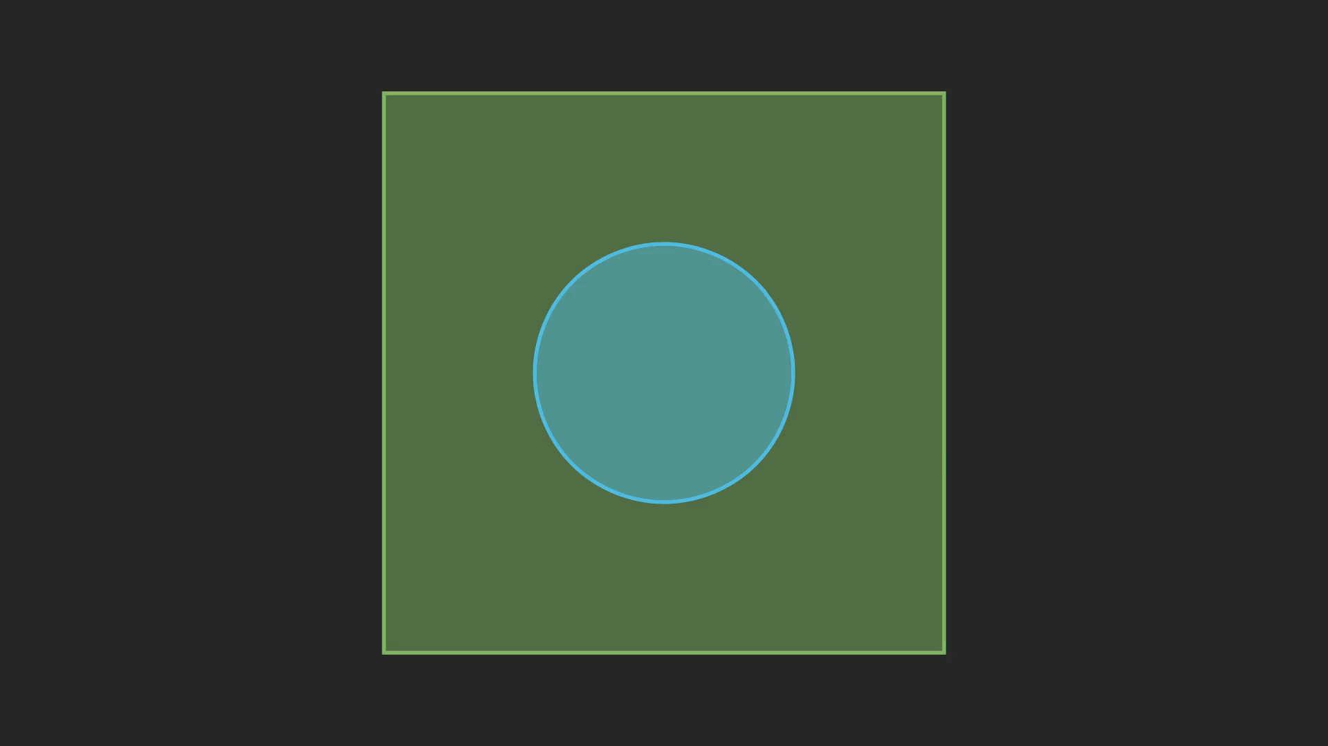

Differentiating One-Bounce
Reynolds Transport Theorem tells us:
$\frac{dI}{dθ}=interior$
$$+ \int_{Boundary}{F\left(p\right)\vec{n}(p)⋅\vec{v}(p)dp}$$
Requires integrating over the visibility boundary
Notes:
Reynolds transport theorem tells us that when differentiating an integral with discontinuities, we have to break down the integral into two parts. We refer to each part as the interior term and the boundary term. The boundary term is what we’re more interested in, as this integral is directly related to discontinuities. Since visibility is the source of discontinuity in our setup, the boundary here is the curve that separates visible parts from invisible parts, and here it is the boundary of the blue circle. For the boundary integral, we need to integrate the contribution multiplied by the dot product between normal and velocity. Note here that, we need to know the velocity of the boundary, which stands for “how fast the boundary moves when theta changes”. In its current form, evaluating this boundary term requires us to integrate over the visibility boundary, which means that we have to be able to detect and sample the discontinuities.

Slide 16

An Outline of Our Method
To obtain the derivative $dI/dθ$, we take three steps
Rewriting $I$ as an integral over a constant “reference” surface (“Material Form Reparametrization”)
Differentiating the integral from 1.
Apply Warped-Area reparametrization to handle discontinuity in 2.
$$I=\int_{Light}{L_{e}\left(x→y\right)G(x↔y)dx}$$
Notes:
Now we move on to step 3, to apply the warped-area reparametrization to handle the discontinuity that we identified in step 2.

Slide 17
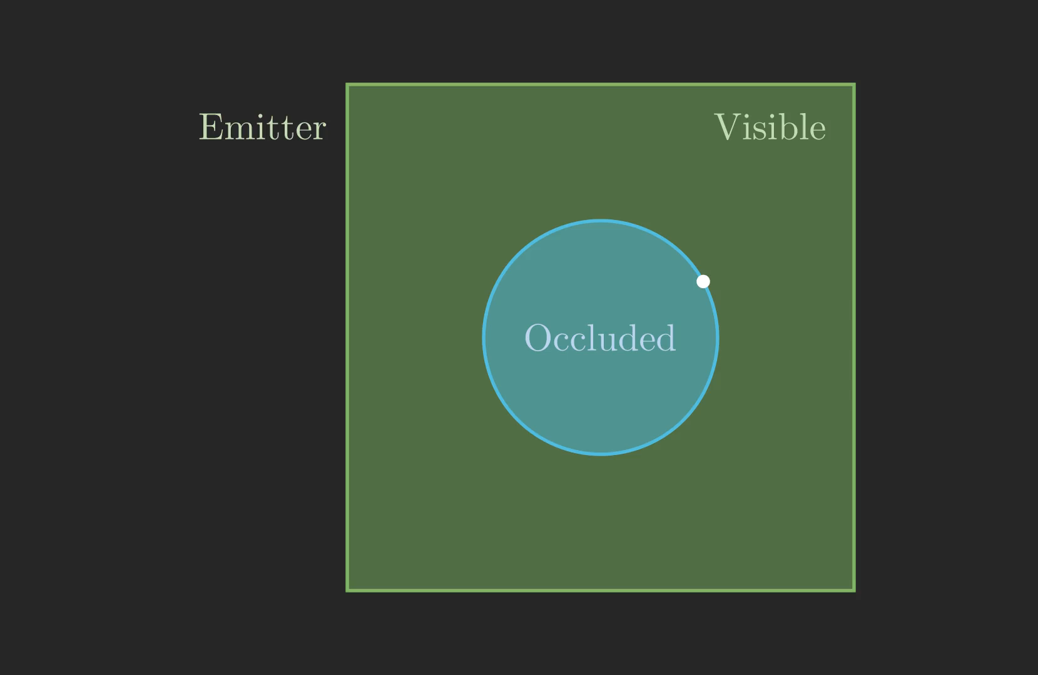

Our Method In One-Bounce
We apply the divergence theorem to calculate the boundary term:
$\int_{Boundary}{[F(\vec{n}⋅\vec{v})](p)dp}$
$$↓$$
$\int_{Visible}{\left[∇⋅\left(F\vec{v}\right)\right]\left(p\right)dp}$,
Where $v$ is the “velocity”
Challenge: Velocity in the interior is not uniquely defined
Notes:
In order to avoid explicit handling of the boundary term, we apply the divergence theorem. Divergence theorem moves an integration over the boundary to an integrationg over its interior. In our case, this interior is the visible parts of the emitter. The problem that arises from applying divergence theorem is that previously, the velocity is defined everywhere on the boundary. However, the velocity is not uniquely defined for the interior, neither the occluded area nor the visible area.

Slide 18
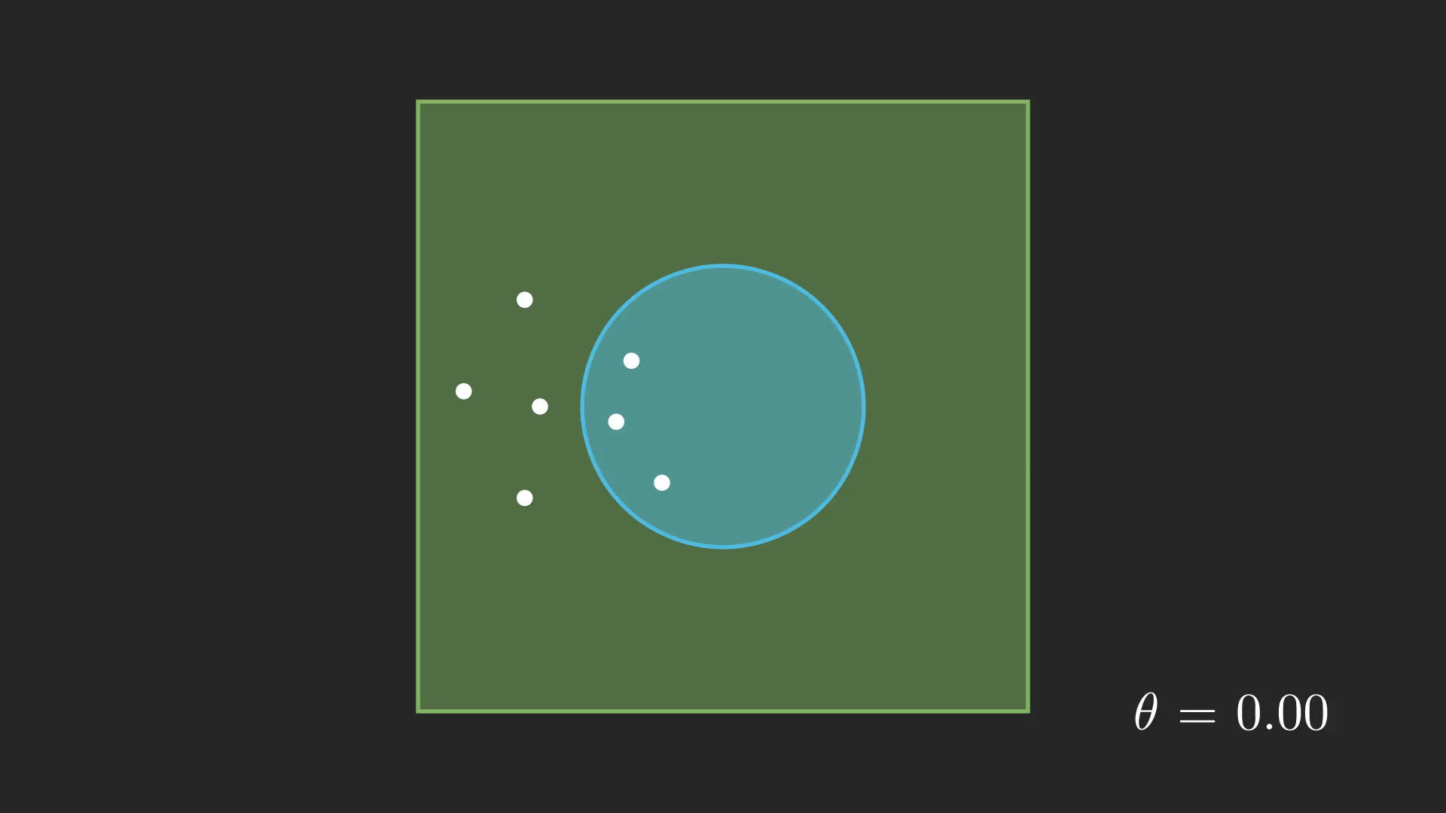
Discontinuous Velocity
There is a way to define a discontinuous velocity in the occluded area
Notes:
We start by noticing that there is a way to define a discontinuous velocity in the occluded area. The velocity can be set to be the same as the moving shadow.

Slide 19
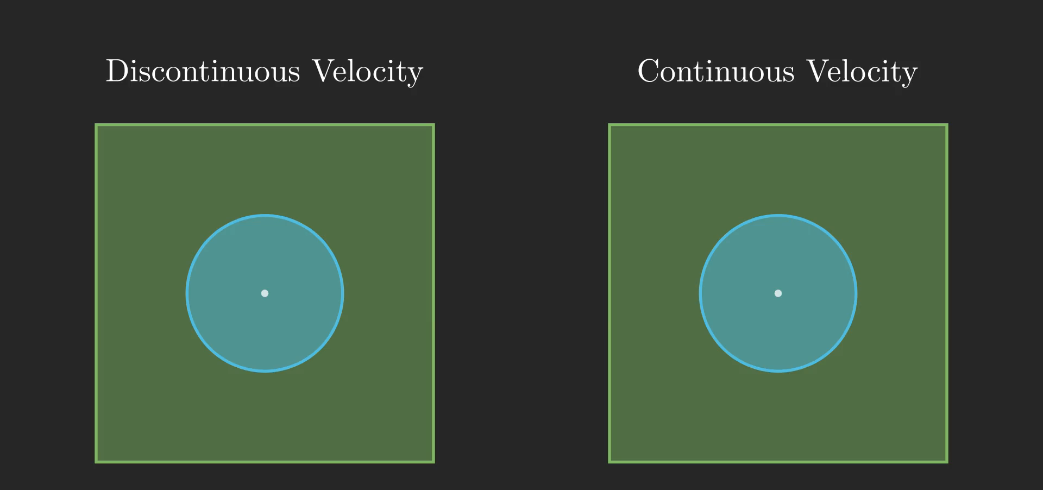
Required Properties of Velocity
Discontinuous velocity is not enough.
Divergence theorem requires the velocity to:
1. Agree with the boundary velocity when point approaches boundary
2. C-0 continuous
Notes:
However, a discontinuous velocity is not enough. In order to apply the divergence theorem, the velocity has to satisfy 2 main properties. First, it must agree with the boundary velocity when the point where we evaluate the velocity approaches boundary. Therefore, we cannot apply simple interpolation techniques like gaussian blurring. Furthermore, the velocity has to be C-0 continuous, so that we can calculate the divergence of the velocity. Therefore, our desired continuous velocity is shown in the animation on the right. We would like to find a way to smoothly interpolate the velocity into the visible area while satisfying the 2 properties here.

Slide 20
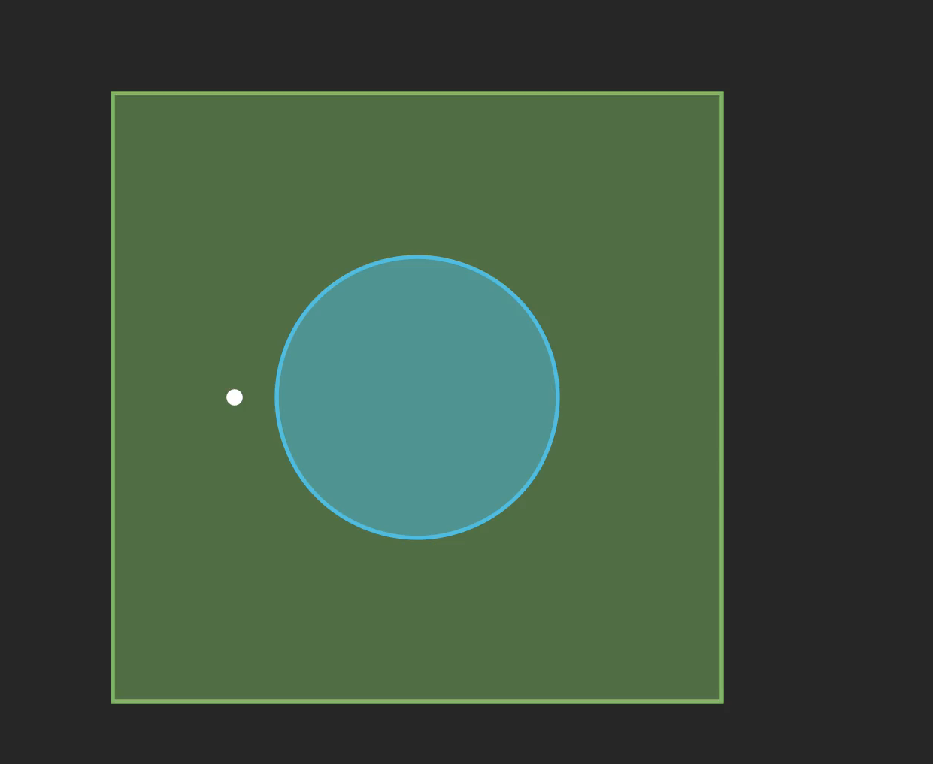

Interpolating Velocity
Convolve the velocities of auxiliary points using harmonic weight:
$$v\left(p\right)=\frac{\int{w\left(q;p\right)v^{dis}\left(q\right)dq}}{\int{w\left(q;p\right)dq}}$$
w is designed to satisfy these properties.
Notes:
In order to achive such interpolation, we apply a convolution of the velocity using a harmonic weight. In practice, we estimate this convolution using monte carlo estimation. We first sample a few auxiliary points around the point of interest, evaluate the discontinuous velocity at the auxiliary points, and interpolate between these velocities. Here, the harmonic weight w is designed to satisfy the properties required by divergence theorem, and please refer to our paper for more details of this weight function.

Slide 21
Difference With Original WAS
Ours:
1. Warped-Area on top of Material form:
2. Only need to handle visibility boundaries
3. Use empirically more robust weighting scheme
Original WAS (Bangaru et al. 2020):
1. Warped-Area Only
2. Requires handling of all types of boundaries
Notes:
So far, we have derived our method in the direct illumination case. And we would like to highlight a few differences between our method and the original WAS proposed by Bangaru et al. Firstly, our method applies warped-area reparametrization on top of material form reparametrization, while the original WAS only applies warped area sampling. Secondly, due to the material form reparametrization, our method only needs to handle visibility boundaries, while the original WAS needs to handle all types of boundaries. Lastly, our method uses an empirically more robust harmonic weight.

Slide 22
Extending to Multi-Bounces
Notes:
Now that we have established our method in the one-bounce case, we can extend our method to multiple-bounces.

Slide 23

Extending to Multi-Bounces
The formulation in one-bounce can be extended to multiple-bounces under material form reparameterization:
$$\frac{dI}{dθ}=\int_{\hat{Ω}}{\left(\frac{d\hat{f}\left(\overline{p}\right)}{dθ}+\sum_{K=0}^{N−1}{\left[∇⋅\left({\hat{f}}_{K}v_{K}\right)\right]\left(p_{K}\right)}\right)d\overline{p}}$$
Furthermore, we introduce an $O(n^{2})$BDPT and $O(n)$PT algorithm (same complexities as forward rendering)
See the paper for more details
Notes:
We note that by using the material form reparametrization, the formulation in one-bounce can be easily extended to multiple-bounces. The formulation in multiple bounces requires us to evaluate the sum of divergence over all path segments. Furthermore, we show that this sum can be calculated efficiently by calculating prefix-sums, and we can eventually derive an O(n^2) BDPT and an O(n) path tracing algorithm, which are the same complexities as forward rendering. Therefore, the sum over all path segments will not affect the big-O complexity of path sampling algorithms in forward rendering. Please see the paper for more details of the derivations.

Slide 24







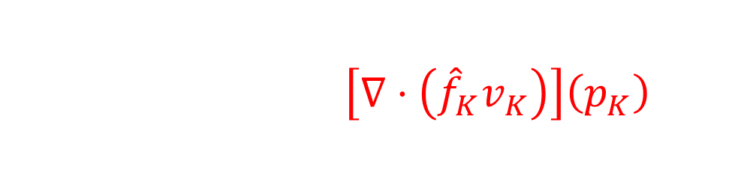


Extending to Multi-Bounces
$$x_{0}$$
$$\int_{\hat{Ω}}{\left(\frac{d\hat{f}\left(\overline{p}\right)}{dθ}+\sum_{K=0}^{N−1}{\left[∇⋅\left({\hat{f}}_{K}v_{K}\right)\right]\left(p_{K}\right)}\right)d\overline{p}}$$
$$Emitter$$
$$K=2$$
$\{x_{0}, x_{1}, x_{2}, x_{3}\}$: Any path sampled using either PT or BDPT
$$x_{3}$$
$$x_{1}$$
$$x_{2}$$
$$p_{0\sim i}$$
Notes:
Here we visualize the process of calculating the boundary term in our method. For a path x1, x2, x3, x4 sampled using any method, we evaluate the divergence term for every path segment…

Slide 25





Extending to Multi-Bounces
$$x_{0}$$
$$\int_{\hat{Ω}}{\left(\frac{d\hat{f}\left(\overline{p}\right)}{dθ}+\sum_{K=0}^{N−1}{\left[∇⋅\left({\hat{f}}_{K}v_{K}\right)\right]\left(p_{K}\right)}\right)d\overline{p}}$$
$$Emitter$$
$$K=1$$
$\{x_{0}, x_{1}, x_{2}, x_{3}\}$: Any path sampled using either PT or BDPT
$$x_{3}$$
$$x_{1}$$
$$p_{0\sim i}$$
$$Occluded$$
$$x_{2}$$

Slide 26



Extending to Multi-Bounces
$$p_{0\sim i}$$
$$x_{0}$$
$$\int_{\hat{Ω}}{\left(\frac{d\hat{f}\left(\overline{p}\right)}{dθ}+\sum_{K=0}^{N−1}{\left[∇⋅\left({\hat{f}}_{K}v_{K}\right)\right]\left(p_{K}\right)}\right)d\overline{p}}$$
$$Emitter$$
$$K=0$$
$\{x_{0}, x_{1}, x_{2}, x_{3}\}$: Any path sampled using either PT or BDPT
$$x_{3}$$
$$x_{1}$$
$$Occluded$$
$$x_{2}$$
Notes:
And we sum them up to get the boundary term, without detecting or sampling any boundary.

Slide 27
Results
Notes:
Here we show some results in our paper.

Slide 28
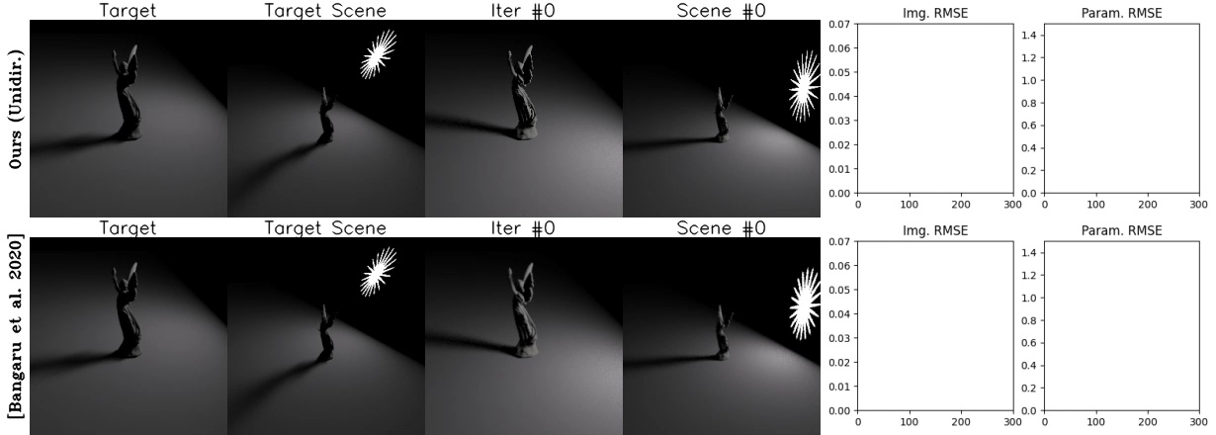
Results
Object illuminated by an star-shaped emitter
Notes:
This scene shows a statue illuminated by a star-shaped emitter, and we optimize the position of the emitter. We compare our method on the top row to the original warped-area sampling in the bottom row. Because we use material form reparametrization and we don’t need to handle emitter boundaries, our method is performes better than the original warped area sampling.

Slide 29
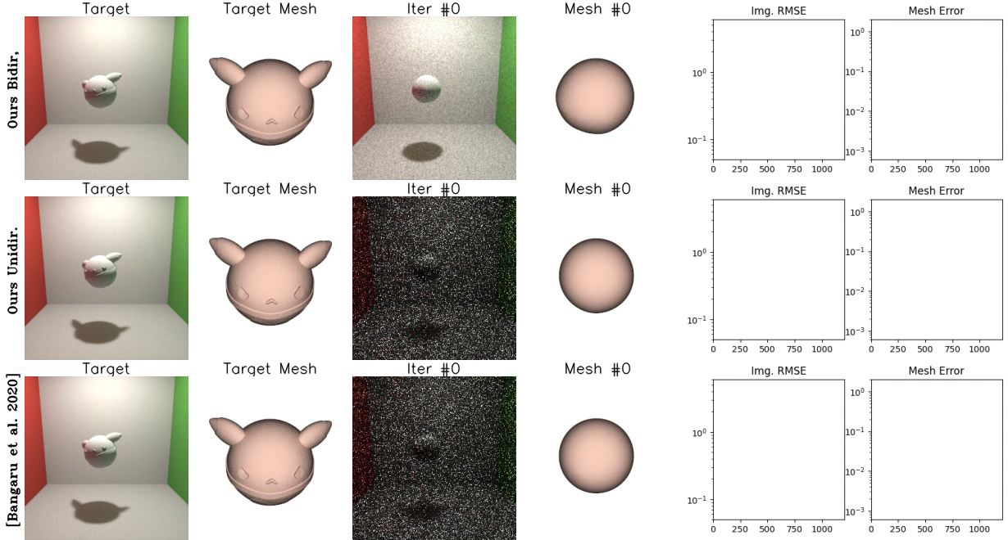
Results
Object illuminated by an area light facing up
Requires BDPT
Notes:
In this experiment we use a cornell box with an area light facing up. This makes the lighting indirect-dominant, and requires BDPT to render. We optimize the shape of the object, and our bidirection algorithm on the top row performs better than unidirectional vesion of our method and the original WAS.

Slide 30
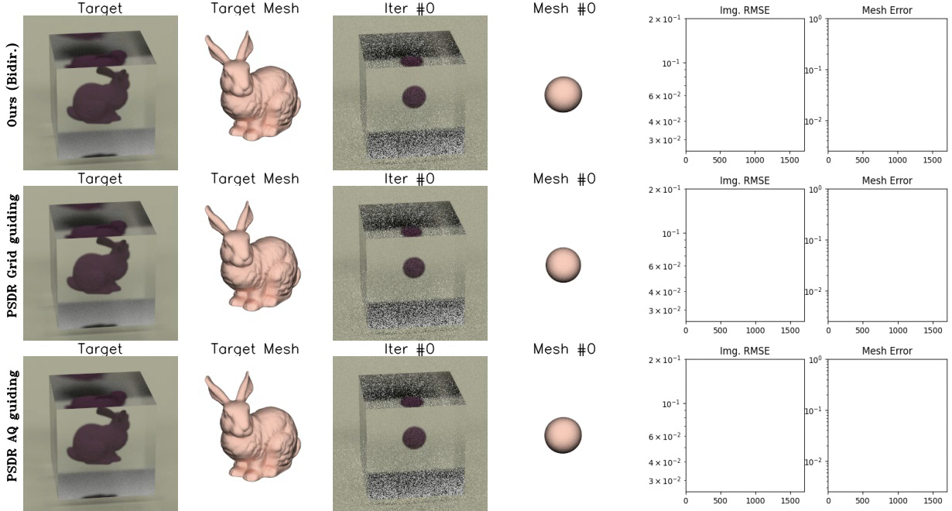
Results
Object in smooth glass illuminated by an area light
Involves specular reflection
Notes:
In this experiment we optimize the shape of an object inside a smooth glass, illuminated by an area light. The scene involves specular reflection which makes explicit sampling of boundary difficult. Our method on the top row utilizes importance sampling in forward rendering, and therefore is capable of handling this scene without any guiding data structure.

Slide 31
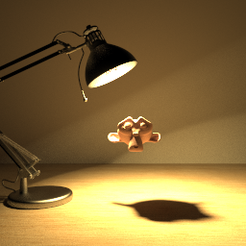
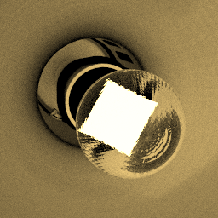
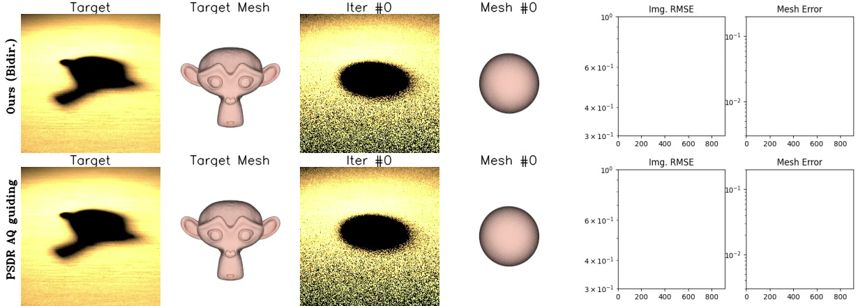
Results
Object illuminated by a lamp with specular glass lightbulb
Requires BDPT
Involves specular reflection
Notes:
In this experiment we optimize the shape of an object that is illuminated by an emitter inside a glossy lightbulb. The scene involves specular reflection and requires BDPT to render. Our method on the top row outperformes the PSDR with aq guiding, which is the state of the art in explicitly sampling boundaries.

Slide 32
Limitations & Future Works
Expand to consider volumetric light transport.
Improve efficiency with advanced light path sampling techniques.
Investigate reparametrization for implicit geometries.
Notes:
Our method also has a few limitations,. In the future we may try to extend our method to consider volumetric light transport, use more efficient path sampling techniques than BDPT, or investigate reparametrization for implicit geometries like SDFs.

Slide 33
Conclusion
In this paper, we:
Formulated reparameterized differential path integrals.
Enabled advanced Monte Carlo estimators without explicit discontinuity handling.
Validated with rendering and inverse rendering tests.
Notes:
In conclusion, in this paper we Formulated reparameterized differential path integrals.
Enabled advanced Monte Carlo estimators without explicit discontinuity handling.
Validated with rendering and inverse rendering tests.

Slide 34

Acknowledgements
Funding: NSF grants 1900927 and 2105806
We thank Guangyan Cai,Wesley Chang, Cheng Zhang for proofreading and all the anonymous reviewers who helped improve this paper.
Project Page:
Notes:
We thank the many people and organizations who fund or helped improve this paper. Our code will be released soon in our project page, thank you!

